Slide 1

The material in this presentation belongs to St. Francis Institute of Technology and is solely for educational purposes. Distribution and modifications of the content is prohibited.
Computer Network & Network Design
Module 3
Network Layer
Lecture 19
St. Francis Institute of Technology
Department of Information Technology
17th Feb 2025
Computer Network & Network Design
Dr. Minal Lopes

Slide 2
Network Layer Design Issues
Responsible for source to destination delivery of data
To reach to destination, data might take many hops through the network
Specific Responsibilities:
  Logical Addressing: every station on the network will have an address, through which it become accessible to every other device on the network.
  Routing: for source to destination delivery of data, the network layer must know the topology of the network (devices and router connections) and should be able to choose appropriate paths through it.
Ref Book: Computer networks- Andrew Tanenbaum

Slide 3

Logical addressing in Network Layer

Slide 4
Network Layer: Logical Addressing
Communication at the network layer is host to host (computer to computer)
A computer somewhere in the world needs to communicate with another computer somewhere else. In today's world these computers communicate through Internet.
The packets transmitted by sender may pass through several LANs or WANs before reaching to the destination. Thus we need addressing (Logical Addressing)
Today, we use the term IP address to mean a logical address in the network layer of the TCP/IP protocol suite.
Ref Book: Data Communication and Networking, Behrouz Farouzan (2nd & 4th Ed)

Slide 5

Internet Addresses
The Internet addresses are 32 bit in length (max 2³² = 4,294,967,296 addresses)
Notations:
  Binary Notation: written as 4 different bytes
  Dotted Decimal Notation: written in decimal form with a decimal point separating the bytes. Number very from 0 to 255

Slide 6
Internet Addresses- examples
111.56.045.78
221.34.7.8.20
75.45.301.14
11100010.23.14.67
Wrong, decimal number should not be preceded by 0
Wrong, not more than four decimal fields
Wrong, decimal number should be between 0 and 255
Wrong, mixture of two notations is not allowed

Slide 7
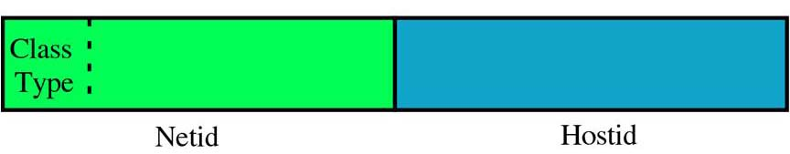
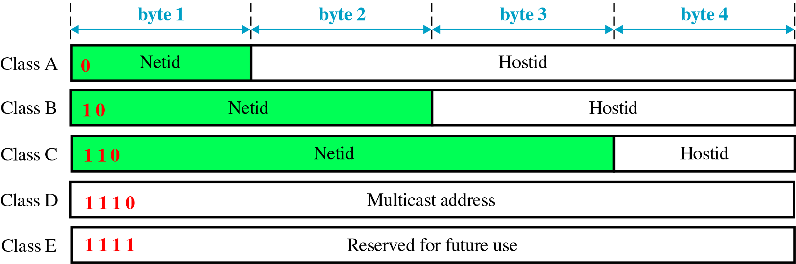
Internet Addresses- classes
Each Internet address is defined by two fields: netid (includes class type) and hostid
These parts very in length depending upon the class of address
(Prefix)
(suffix)

Slide 8

Finding the classes in binary and dotted-decimal notation

Slide 9
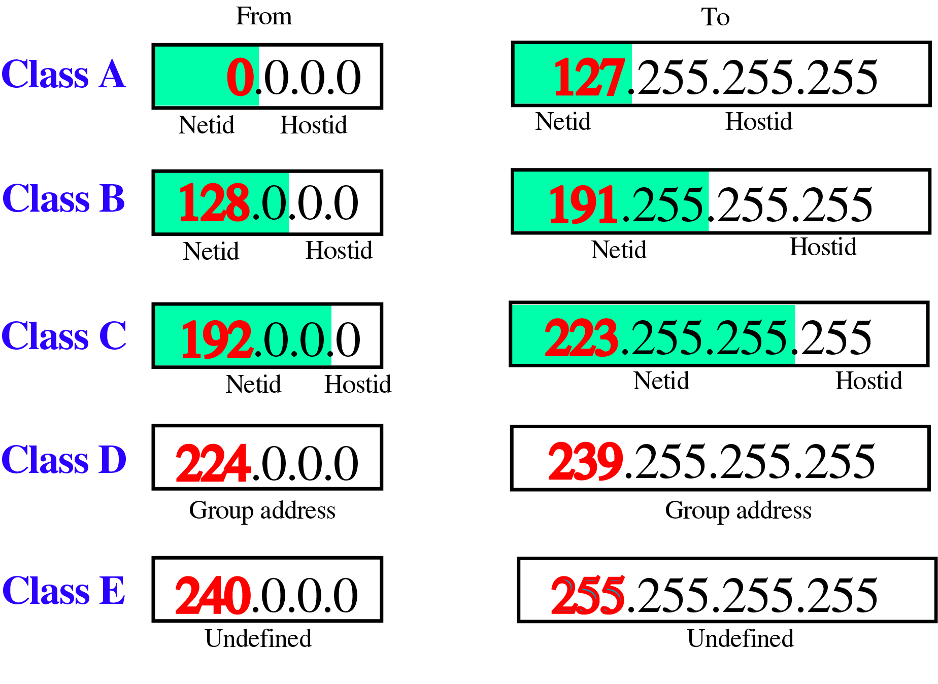
Class ranges of Internet Addresses

Slide 10
Exercise
Find the class of each address
  4.23.145.90
  227.34.78.7
  246.7.3.8
  129.6.8.4
  198.76.9.23
Answers:
  Class A
  Class D
  Class E
  Class B
  Class C

Slide 11
Why Classes ?
Different classes are designed to cover needs of different types of organizations.
E.g. Class A addresses are numerically lowest and is largest set of host addresses compared to others
Can be used in large organizations
Exercise:
  How many Host Id’s are available in,
    Class A:
    Class B:
    Class C:
  What is the Network address for Class A?
  What is the default gateway address for Class A?
  What is the default broadcast address for Class A?

Slide 12
The material in this presentation belongs to St. Francis Institute of Technology and is solely for educational purposes. Distribution and modifications of the content is prohibited.
Computer Network & Network Design
Module 3
Network Layer
Lecture 20
St. Francis Institute of Technology
Department of Information Technology
18th Feb 2025
Computer Network & Network Design
Dr. Minal Lopes

Slide 13
Concept of Subnetting
An IP address contains two ID’s
  Network ID
  Host ID
It follows the hierarchy of network followed by host.
To reach to a host on the Internet, we must first reach the network using netid. Then we must reach to the host using hostid.
This design of addresses is called “Two Levels of Hierarchy”
has limitation – The number of hierarchy levels are not enough

Slide 14
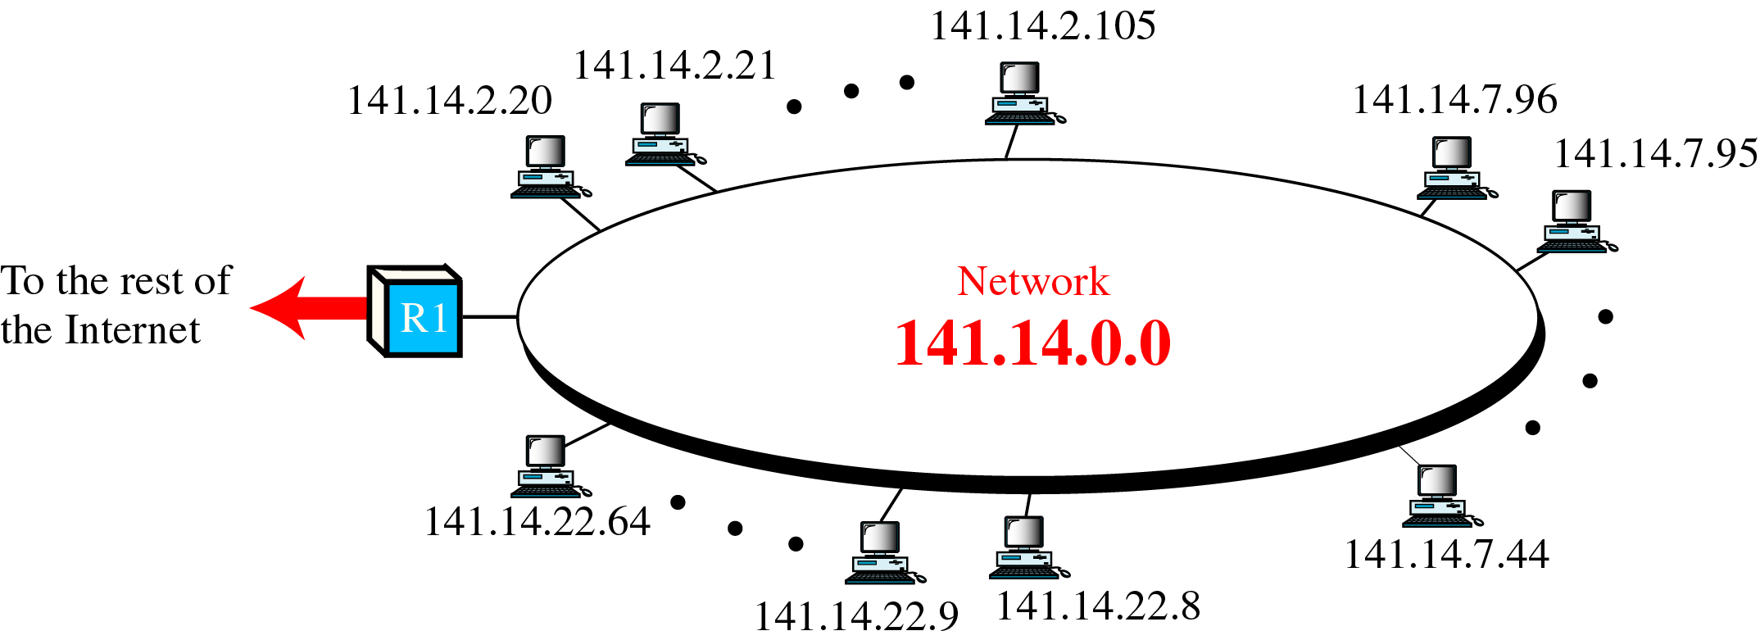
A Network with Two Levels of Hierarchy

Slide 15
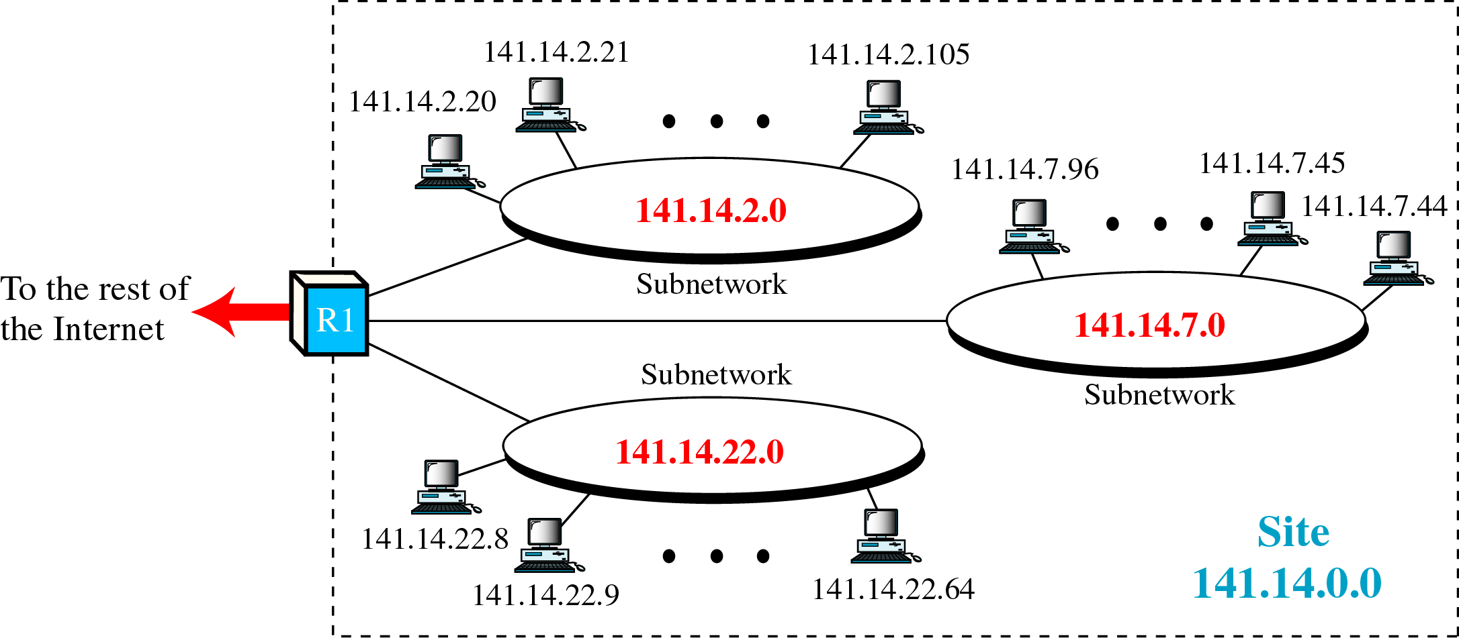
A Network with Three Levels of Hierarchy

Slide 16
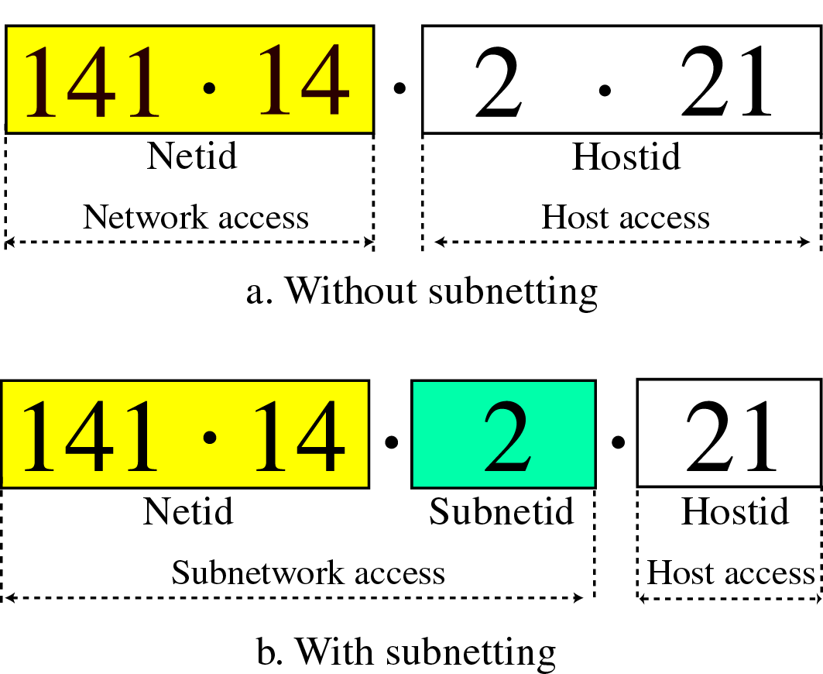
Three Levels of Hierarchy in an IP Address
Adding subnetworks creates an intermediate level of hierarchy in the IP addressing system.
Thus, the three levels are
  Netid
  Subnetid
  Hostid

Slide 17
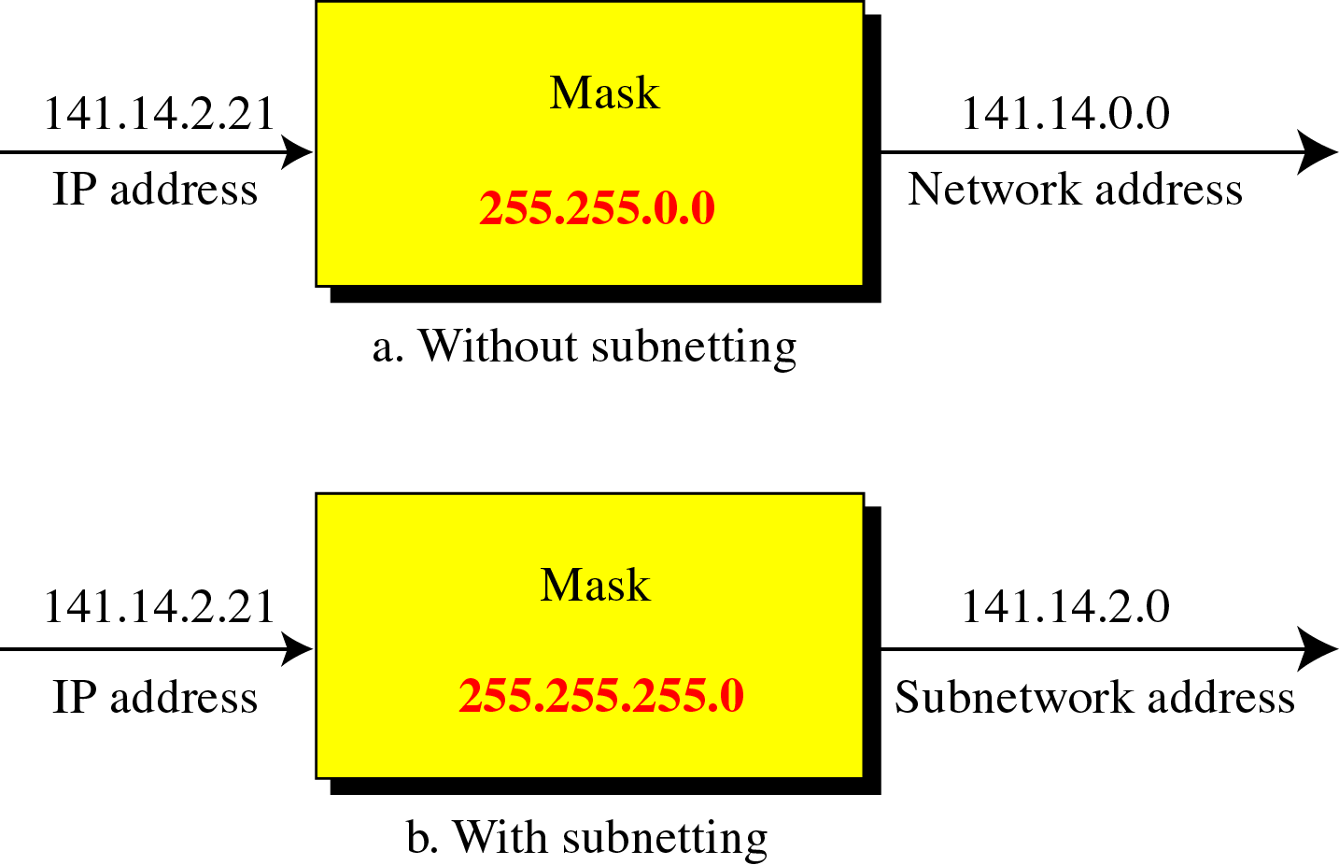
Masking
Masking is the process that extracts the network address from an IP address. Use AND operation.

Slide 18
Masking- without subnetting examples
Class | Mask | Address (Example) | Network Address
A |  | 15.32.56.7
B |  | 135.67.13.9
C |  | 201.34.12.72
D | N/A | N/A | N/A
E | N/A | N/A | N/A
255.0.0.0
15.0.0.0
255.255.0.0
135.67.0.0
255.255.255.0
201.34.12.0

Slide 19
Masking- more examples
For address 132.7.21.84 find the class and network address.
Ans:
A router receives the packet with destination address 190.240.34.95. if subnet mask is 19 (first 19 bits are 1’s and rest are 0’s) find subnet address.
Type of Network: Class B (ranges from 128.0.0.0 to
191.255.255.255)
Mask : 255.255.0.0
Network Address: 132.7.0.0
Ans: Given IP : 190.240.34.95
Binary form : 10111110 11110000 00100010 01011111
Subnet Mask : 11111111 11111111 11100000 00000000
Subnet Addr : 10111110 11110000 00100000 00000000
Decimal notation: 190.240.32.0

Slide 20
The material in this presentation belongs to St. Francis Institute of Technology and is solely for educational purposes. Distribution and modifications of the content is prohibited.
Computer Network & Network Design
Module 3
Network Layer
Lecture 21
St. Francis Institute of Technology
Department of Information Technology
20th & 24st Feb 2025
Computer Network & Network Design
Dr. Minal Lopes

Slide 21
Masking- with & without subnetting
Class | Mask without subnetting | Mask with subnetting
A | 255.0.0.0 | 255.255.0.0
B | 255.255.0.0 | 255.255.255.0
C | 255.255.255.0

Slide 22
Masking- subnetting examples
Class | Subnet Mask | Address (Example) | Subnetwork Address
A |  | 15.32.56.7
B |  | 135.67.13.9
C |  | 201.34.12.72
D | N/A | N/A | N/A
E | N/A | N/A | N/A
255.255.0.0
15.32.0.0
255.255.255.0
135.67.13.0
255.255.255.192
201.34.12.64
Source: http://www.mhhe.com/forouzan/cn

Slide 23
Subnetting in Class C
netid
netid
netid
hostid
Bits allocated for subnet from hostid | Hostid byte in Mask | Mask for extracting subnet addr | No. of subnets | No. of Hosts
1 | 1000 0000 | 255.255.255.128 | 2¹=2 | 2⁷=128
2 | 1100 0000 | 255.255.255.192 | 2²=4 | 2⁶=64
3 | 1110 0000 | 255.255.255.224 | 2³=8 | 2⁵=32
4 | 1111 0000 | 255.255.255.240 | 2⁴=16 | 2⁴=16
5 | 1111 1000 | 255.255.255.248 | 2⁵=32 | 2³=8
6 | --- | ----- | ---- | ----

Slide 24
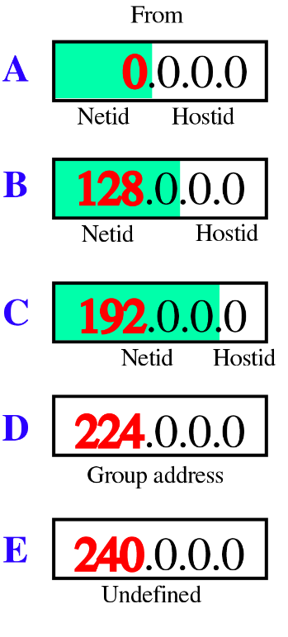
More excercises
Which of the following is a class A host address?
  128.4.5.6
  117.4.5.1
  117.0.0.0
  117.8.0.0
Which of the following is a class B host address?
  230.0.0.0
  130.4.5.6
  145.20.0.0
  30.4.5.6
Which of the following is a class C host address?
  230.0.0.0
  130.4.5.6
  200.1.2.3
  30.4.5.6

Slide 25
More excercises
Find the netid and hostid bytes for each address
  4.23.145.90
  227.34.78.7
  246.7.3.8
  129.6.8.4
  198.76.9.23
Answers
  Class A, netid:4.0.0.0, hostid bytes:23.145.90
  Class D, no hostid, no netid
  Class E, no hostid, no netid
  Class B, netid: 129.6.0.0, hostid bytes: 8.4
  Class C, netid: 198.76.9.0, hostid byte: 23

Slide 26
More exercises
Find the subnetwork address for the following:
  IP addr: 125.34.12.56, mask: 255.255.0.0
  IP addr: 120.14.22.16, mask: 255.255.128.0
  IP addr: 141.181.14.16, mask: 255.255.224.0
Ans:
  125.34.0.0
  120.14.0.0
  141.181.0.0

Slide 27
The material in this presentation belongs to St. Francis Institute of Technology and is solely for educational purposes. Distribution and modifications of the content is prohibited.
Computer Network & Network Design
Module 3
Network Layer
Lecture 22
St. Francis Institute of Technology
Department of Information Technology
24th & 25th Feb 2025
Computer Network & Network Design
Dr. Minal Lopes

Slide 28
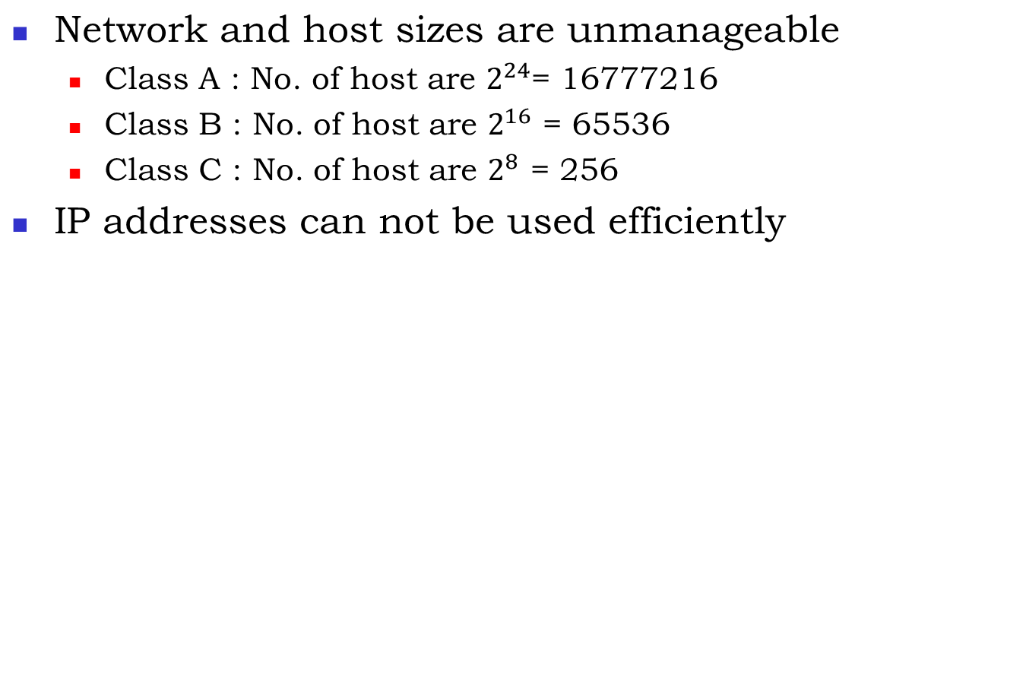
Disadvantages of Classful addressing
, No. of n/w = 2⁸
, No. of n/w = 2¹⁶
, No. of n/w = 2²⁴
0
1
0
Class B
Class A
1
1
0
Class C
1
1
1
0
Class D
1
1
1
1
Class E
Ref Book: Forouzan 4th Ed –Topic: Classful addressing, book Page 552

Slide 29
CIDR (Classless inter-domain Routing)
Block of IP addresses
Range of IP address is commonly called as BLOCK.
CIDR replaces ‘netid’ by ‘blockid’.

Slide 30
CIDR (Classless inter-domain Routing)
CIDR is a way to allow more flexible allocation of IP addresses than what was possible with the original system of IP address classes
It supports ‘Variable Length Subnet Masking’ (VLSM) for efficient use of IP addresses
Number of available Internet addresses were greatly increased due to CIDR
Along with network address translation (NAT), it has significantly extended the useful life of IPv4

Slide 31
CIDR Notation
CIDR IP is written as a.b.c.d/n
  Where ‘n’ represents subnet mask
  e.g. 10.20.30.40/24
  /24 is equivalent to subnet mask 255.255.255.0 (24, 1’s in binary notation)
Given an IP address, how to find netid (blockid) and hostid ?

Slide 32
CIDR Advantage (supernetting)
20.10.50.100/20
  Netid is 20 bit
  Hostid is (32-20)=12 bits
Easy to find range of block
  Set all 12 bits of hostid to zero
  Set all 12 bits of hostid to one
  20.10.50.100/20 belongs to the block
    20.10.00110010.01100100
    20.10.00110000.00000000 = 20.10.48.0/20
    20.10.00111111.11111111 = 20.10.63.255/20
Any IP from the block can represent the entire block
CIDR IP always represent a block of IP addresses (supernetting)
Network
Address
Broadcast
Address

Slide 33
Exercise
Find range of CIDR IP addresses and no. of valid hosts.
  20.10.30.33/27
  100.1.2.40/28
  150.10.20.100/26

Slide 34
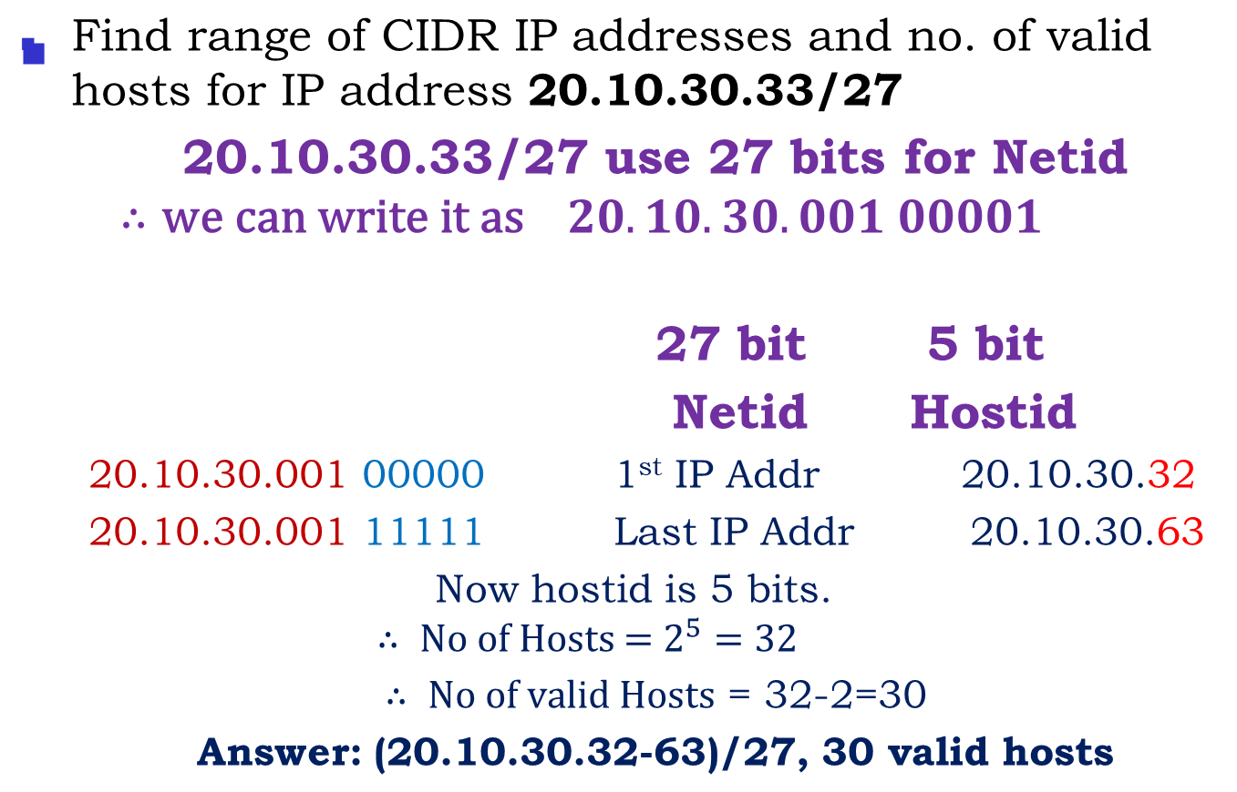
Exercise Solution

Slide 35
Exercise
Find range of CIDR IP addresses and no. of valid hosts.
  20.10.30.33/27
  100.1.2.40/28
  150.10.20.100/26
Answers:
  32-63, 30 valid hosts
  32-47, 14 valid hosts
  64-127,62 valid hosts

Slide 36
Private and Public IP Addresses
For efficient use, IPv4 address space is divided into public and private sections.
Private addresses:
  reserved addresses
  to be used only internally within a company’s network.
Public addresses:
  Registered addresses (with IANA or Internet Registry)
  Used for external communication
When we want to send anything on the Internet, private addresses needs to be mapped to a company’s external registered address.

Slide 37
Private and Public IP Addresses
Network Address Translation (NAT) is used to map private addresses to public addresses
RFC 1918, Address Allocation for Private Internets, defines the private IPv4 addresses as follows:
  10.0.0.0 to 10.255.255.255
  172.16.0.0 to 172.31.255.255
  192.168.0.0 to 192.168.255.255
The remaining addresses are public addresses
Note: Internet RFC documents are written definitions of the Internet’s protocols and policies

Slide 38
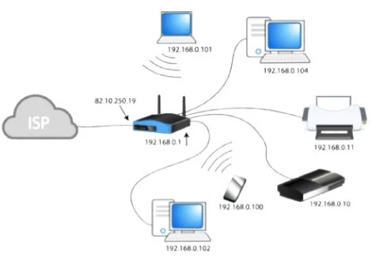
Example
whatismyipaddress.com
Public Addresses in use
Private Addresses in use
Source: https://whatismyipaddress.com/private-ip

Slide 39
The material in this presentation belongs to St. Francis Institute of Technology and is solely for educational purposes. Distribution and modifications of the content is prohibited.
Computer Network & Network Design
Module 3
Network Layer
Lecture 23
St. Francis Institute of Technology
Department of Information Technology
25th & 26th Feb 2025
Computer Network & Network Design
Dr. Minal Lopes

Slide 40
Network Layer: Internetwork Protocol (IP)
At network layer TCP/IP model supports internetwork Protocol(IP)
Internet is a well-known user of TCP/IP model
Internet has chosen Datagram approach for switching and connectionless approach for routing the packets
IP , in turn, contains four supporting protocols
  ARP: Address Resolution Protocol
  RARP: Reverse Address Resolution Protocol
  ICMP: Internet Control Message Protocol
  IGMP: Internet Group Message Protocol

Slide 41
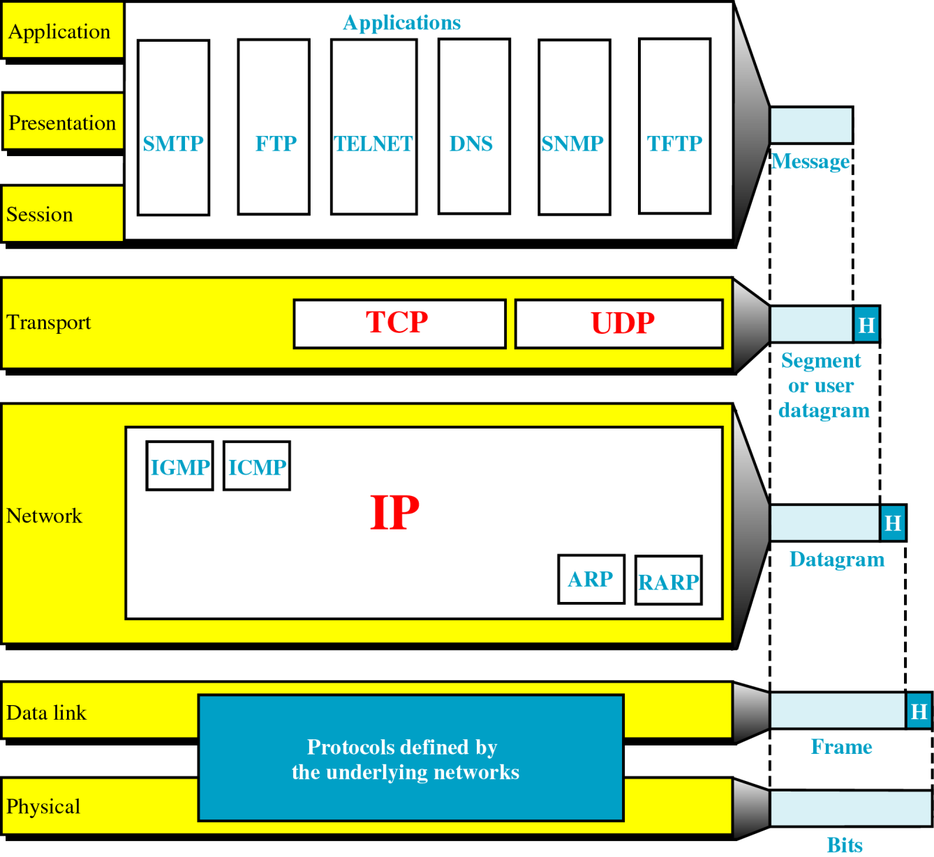
TCP/IP and the OSI Model

Slide 42
Internetwork Protocol (IP)
IP is a transmission mechanism used by the TCP/IP
It is unreliable and connectionless datagram protocol- a best effort delivery service
Best effort means IP does not provide error detection and correction
IP assumes the unreliability of the underlying layers and does its best to transmit the data to its destination, but with no guarantee
Reasons for unreliability can be: Noise causing bit errors, a congested router may discard a datagram if it is unable to relay it before a time limit runs out, routing can end in looping of packets which will be destructed, disabled links
If reliability is important, IP must be paired with a reliable protocol such as TCP or DLL protocols flow & error control

Slide 43
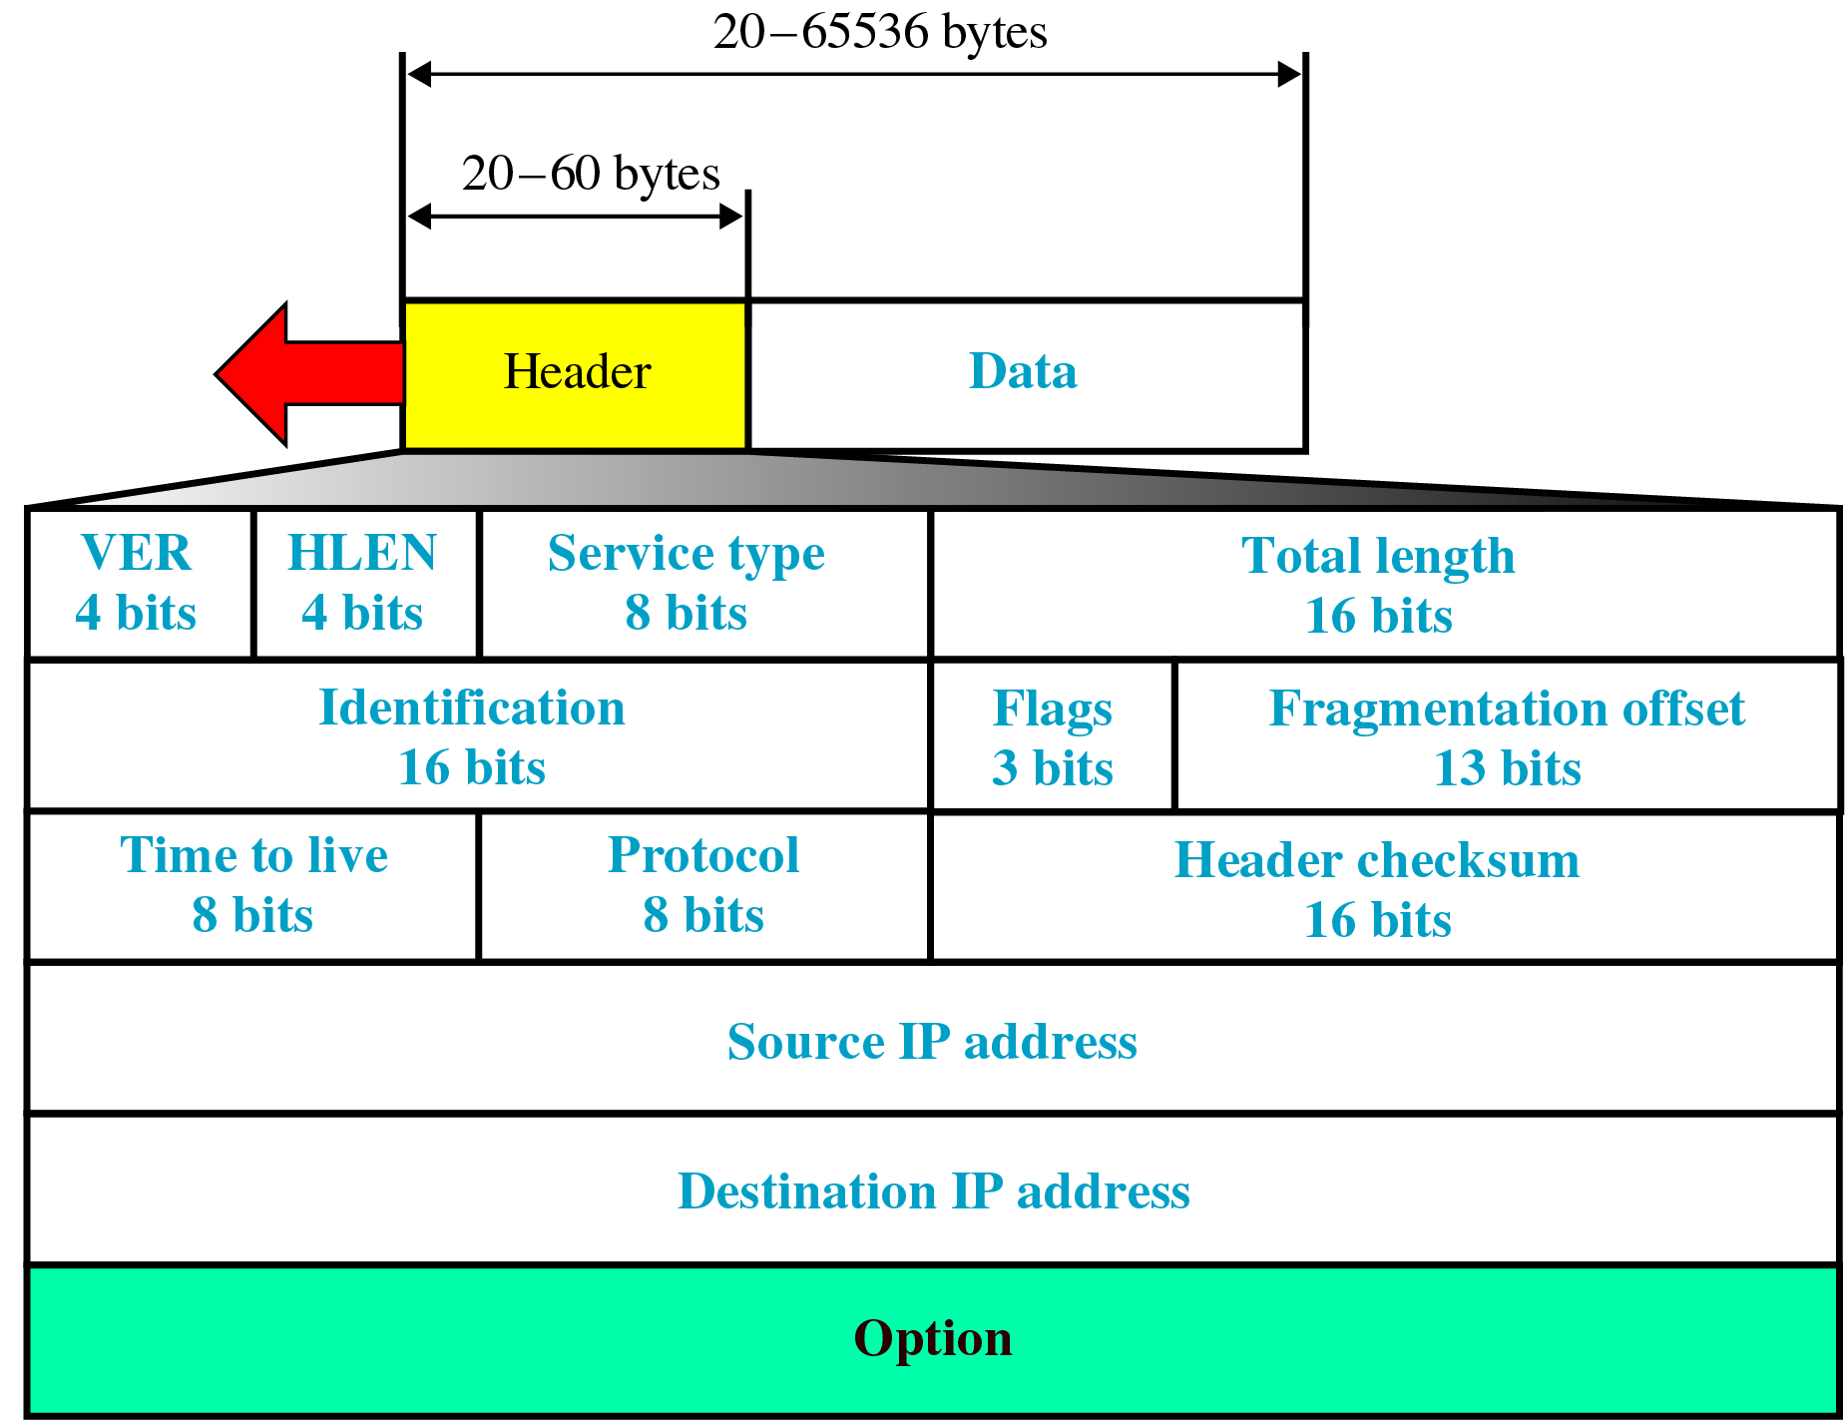
Internetwork Protocol (IP)- continued
IP transports data in packets called Datagrams
As IP is connection-less service, Datagrams can travel along different routes and may arrive out of sequence, lost, corrupted or duplicated
A datagram is a variable length packet consisting of two parts: Header and Data
The Header can be from 20 to 60 bytes and contains information essential to routing and delivery

Slide 44
IP Datagram

Slide 45

Internetwork Protocol (IP)- datagram
Version: defines the version number of IP. Set to 4 (0100) for IPv4
Header length (HLEN): defines the length of the header in multiples of four bytes
Service type (differentiated services): defines services with which a datagram should be handled
  Precedence bits defines the priority of the datagram in issues like congestion
  TOS (type of service) bits indicates types of services

Slide 46

Internetwork Protocol (IP)- datagram
Total length: defines the total length of the IP datagram in bytes
Identification: used in fragmentation. A datagram when passing through different networks, may be divided into fragments to match the network frame size. In such case each fragment is identified with a sequence number in this field
Flags: used in fragmentation
Fragmentation Offset: is pointer that shows the position of data in the original datagram
Time to Live: defines number of hops a datagram can travel before it is discarded

Slide 47
Internetwork Protocol (IP)- datagram
Protocol: defines which upper-layer protocol is been used.(TCP,UDP etc)
Header checksum: used for error control of only header part
Source address: a four byte IP address. A source of datagram
Destination address: a four byte IP address. Final destination of datagram
Option: used to define more functionality to the IP datagram. It can carry fields that control routing, timings, management etc

Slide 48
Exercise:
The size of option field of an IP datagram is 20 bytes. What is the value of HLEN? What is the value in binary?
[Note: In HLEN, when there is no option field, the header length is 20 bytes, and the value of HLEN =5 (0101) (5*4=20). When the option field is of maximum size, header length is 60 bytes, then HLEN = 15 (1111)(15*4=60)]
Answer: HLEN = 10 (1010)
An IPV4 packet has arrived with the first 8 bits as shown: 01000010. The receiver discards? Why? [4]
First 4 bits represents type of IP protocol : IPv4 (0100). The next 4 bits represent HLEN field value which vary from 5 to 15. In given example this value is 0010 = 2, therefore receiver discards it.

Slide 49
The material in this presentation belongs to St. Francis Institute of Technology and is solely for educational purposes. Distribution and modifications of the content is prohibited.
Computer Network & Network Design
Module 3
Network Layer
Lecture 24
St. Francis Institute of Technology
Department of Information Technology
25th & 27th Feb 2025
Computer Network & Network Design
Dr. Minal Lopes

Slide 50

Working Of Network Layer
Store-and-Forward Packet Switching
router
D
Host 2
B
H1
H2
A
E
F
C
Host 1
LAN
Packet
subnet
Ref Book: Computer networks- Andrew Tanenbaum

Slide 51
Services Provided to the Transport Layer
Two Types:
  Connection Oriented Service
  Connectionless Service
    Packets are injected into the subnet individually and routed independently
    No advanced setup of path is needed
    Packets are called “Datagrams”
    Subnet (group of routers) is called as “Datagram Subnet”

Slide 52




Working of Datagram Subnet
router
D
Host 2
B
H1
E
1
F
H2
A
C
Host 1
LAN
A’s table
initially
later
C’s table
E’s table
A | -
B | B
C | C
D | B
E | C
F | C
A | -
B | B
C | C
D | B
E | B
F | B
A | A
B | A
C | -
D | D
E | E
F | E
A | C
B | D
C | C
D | D
E | -
F | F
Destination
Line

Slide 53
Services Provided to the Transport Layer
Connection-Oriented Service
  A path from source to destination must be established before any data packet is to be sent
  This established path is called “Virtual Circuit”
  “Connection Setup” : When a connection is established, a route from source to destination is stored in tables inside the routers
  The same route is used for all traffic flowing over the connection
  When the connection is released, the virtual circuit is also terminated
  Each packet carries an identifier telling which virtual circuit it belongs to
  Routers has the ability to replace connection identifiers in outgoing packets, called as “Label Switching”

Slide 54

Working of Virtual-circuit Subnet
router
H3
D
Host 2
B
H1
E
1
F
H2
A
C
Host 1
LAN
Connection 1
A’s table
in
out
C’s table
E’s table
H1 | 1
H3 | 1
C | 1
C | 2
A | 1
A | 2
E | 1
E | 2
C | 1
C | 2
F | 1
F | 2
Packet source
Connection Identifier

Slide 55
Comparison of Virtual-Circuit and Datagram Subnets
Issue | Datagram Subnet | Virtual-circuit subnet
Circuit setup | Not needed | required
Addressing | Each packet contains the full source and destination address | Each packet contains a short VC identifier
State Information | Routers do not hold state information about connections | Each VC requires router table space per connection
Routing | Each packet is routed independently | Route is chosen when VC is setup, all packets follow it
Effect of router failure | None, except for lost during the crash | All VCs that passed through the failed router are terminated
Quality of Service | Difficult | Easy if enough resources are allocated
Congestion Control | Difficult | Easy if enough resources are allocated

Slide 56
Routing Algorithms
Requirements :
  The pathway with the lowest cost is considered the best
  The metrics like distance, number of hops or estimated transit time can be used for optimization of path
  Once the cost is known, router can find the optimal path
Types: Non-Adaptive (Static routing)
  Do not base their routing decisions on measurements or estimates of the current traffic and topology
  The choice of the route between nodes is computed in advance, off-line and downloaded to the routers when the network is booted
Adaptive (Dynamic routing) Change their routing decisions to reflect changes in the topology and the traffic
  Use local, adjacent or all routers for updating routing tables
Ref Book: Data Communication and Networking, Behrouz Farouzan (2th Ed)

Slide 57
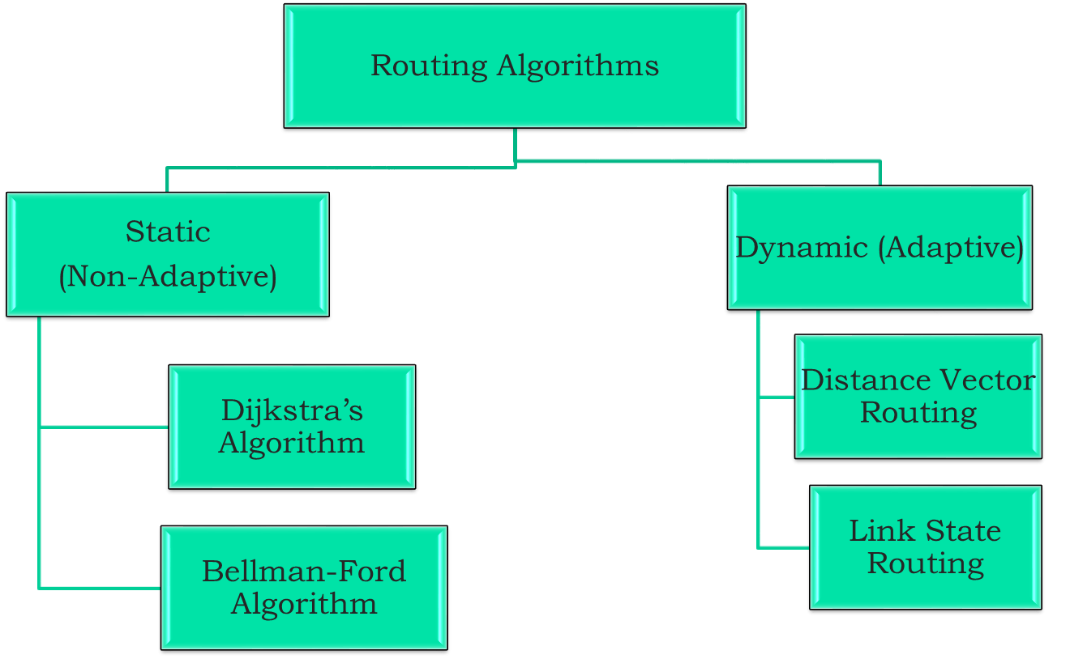
Routing Algorithms

Slide 58
Distance Vector Routing- Dynamic Routing Algorithm
Each router periodically shares its knowledge about the entire network with its neighbors in following 3 steps:
  Knowledge about the whole network: each router shares its knowledge about the network. How much it knows is unimportant. It sends whatever it knows
  Routing only to neighbors: each router periodically sends its knowledge to neighboring routers. The neighbor use this information to update its own routing table
  Information sharing at regular intervals: At regular intervals each router sends its information to its neighbors. This sharing takes place whether or not the network has changed since the last time information is exchanged

Slide 59
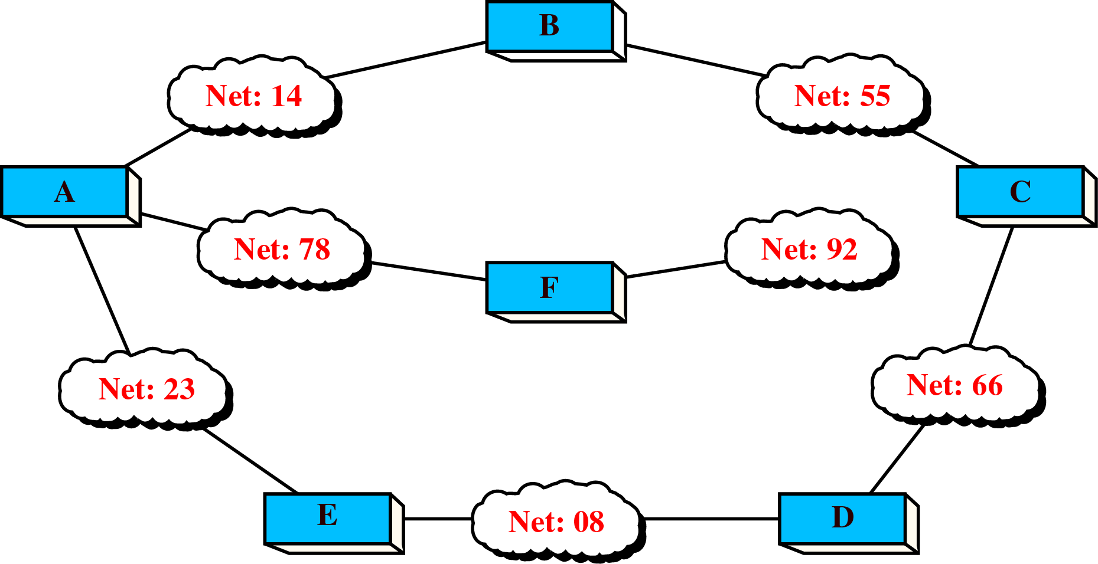
Example of an internetwork

Slide 60
Distance Vector Routing- internet Example
Consider the example of an internetwork
The clouds represent local area networks (E.g.- Ethernet or Token Ring LANs )
The number inside the cloud is the network ID
LANs are connected by routers A, B,C,D,E, and F
Distance vector routing assumes the cost of every link as one unit
Thus efficiency of transmission is a function of number of links required to reach a destination
In this the path cost is based on the hop count

Slide 61
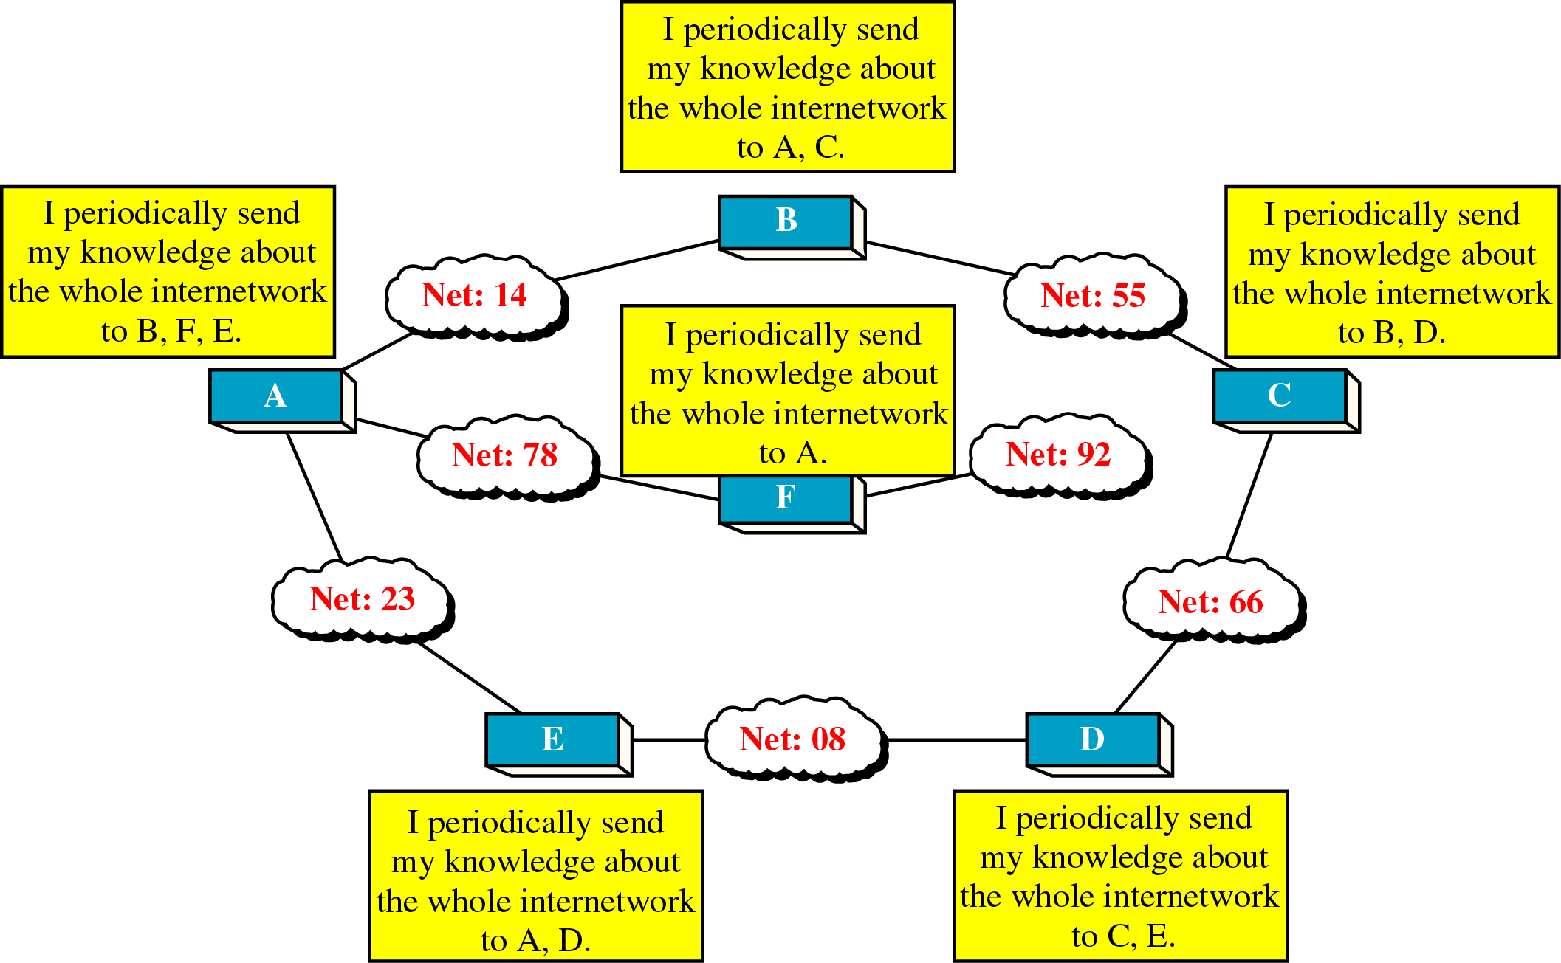
Distance Vector Routing- Sharing Information

Slide 62
Distance Vector Routing- Sharing Information
The text boxes indicate the relationship of the routers to their neighbors
Each router sends its information about the internetwork only to its immediate neighbors
The neighbors add this knowledge to their own knowledge and send the whole table to their own neighbors
In this way the first router gets its own information back plus new information about its neighbor's other neighbors
Thus eventually, every router knows about every other router in the internetwork

Slide 63
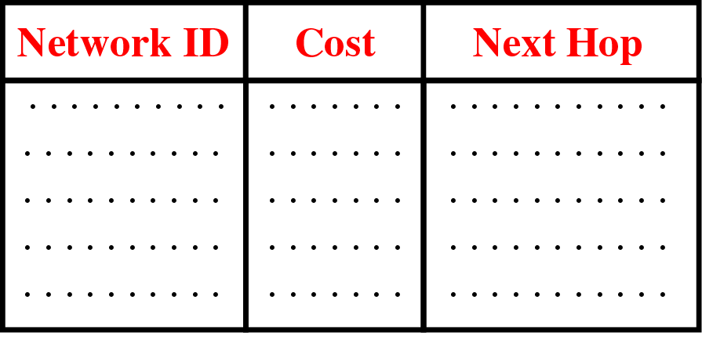
Distance Vector Routing - Routing Table
At startup a router’s knowledge of the internetwork is sparse
All it knows is number of LAN’s it is directly connected to
The routing table contains network ID, the cost and the ID of the next router
The network ID is the final destination of the packet
The cost is number of hops a packet must take to get there
The next hop is the next router to which a packet must be delivered

Slide 64
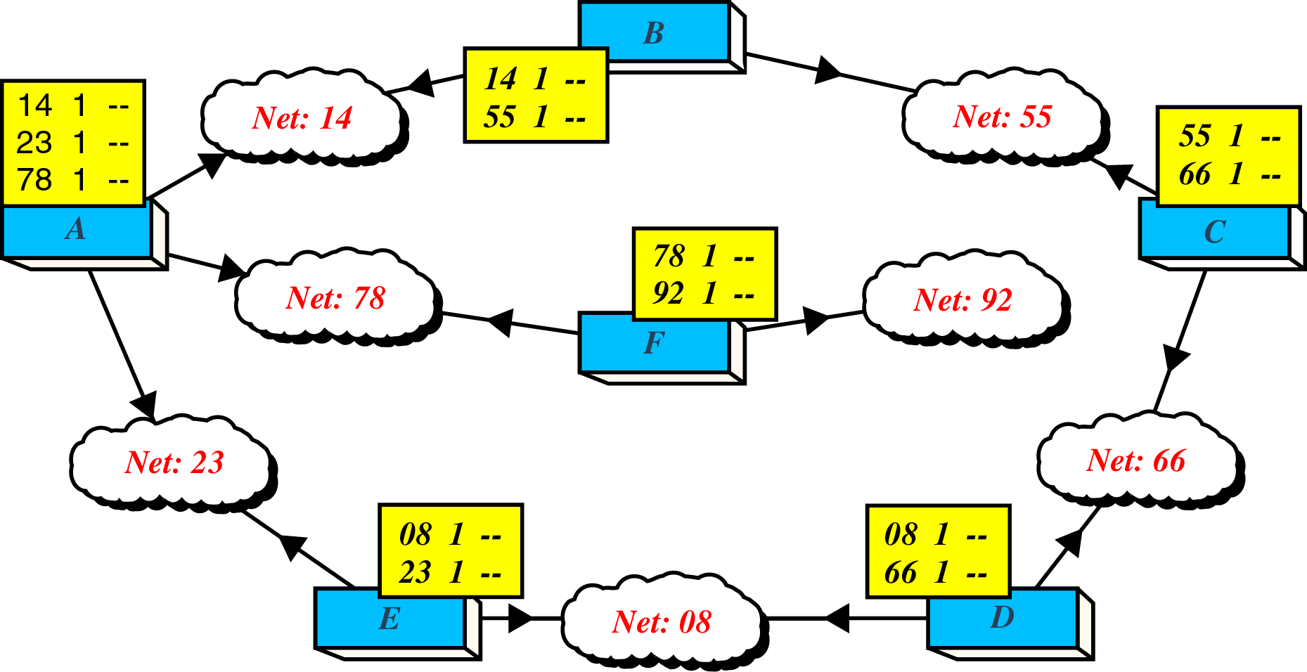
Distance Vector Routing – Initial Routing Table
The third column is empty initially as the routers still has to learn the network
This basic tables are then sent out to neighbors for sharing the information
E.g.- A sends its routing table to routers B, F & E etc

Slide 65
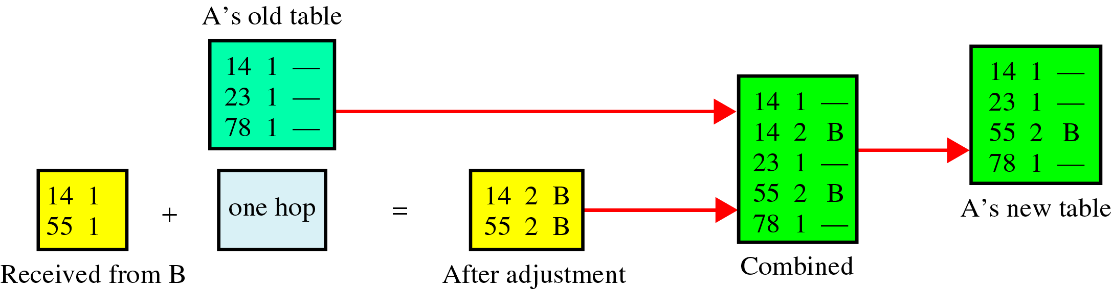
Distance Vector Routing - Updating Routing Table
Router A receives a routing table from B
Updates its routing table
This process is continued for all the routers
Every router receives information from neighbors and updates its routing table

Slide 66
Distance Vector Routing- Updating Algorithm
Let every router first add one to the hop count field for every advertised route
1) If the advertised destination is not in the routing table, the router should add the advertised information to the table
2) If the advertised destination is in the routing table,
  a) If the next hop field is same, the router should replace the entry in the table with the advertised one (Note: even if the advertised hop count is larger, the advertised entry should replace the entry in the table because the new information invalidates the old)
  b) If the next-hop field is not the same,
    i) If the advertised hop count is smaller than the one in the table, the router should replace the entry in the table with the new one
    ii)If the advertised hop count is not smaller, the router should do nothing

Slide 67
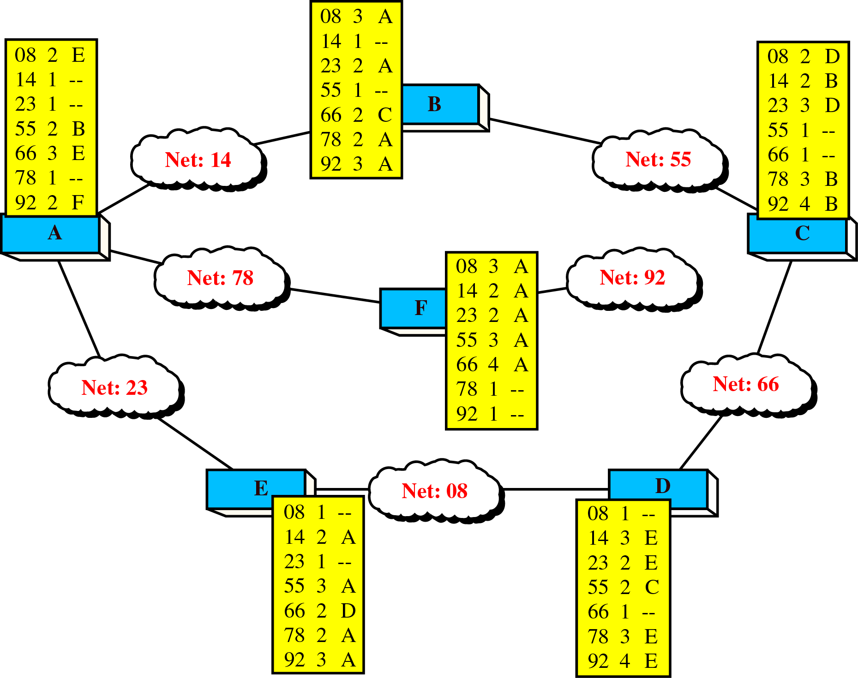
Distance Vector Routing - Final Routing Tables

Slide 68
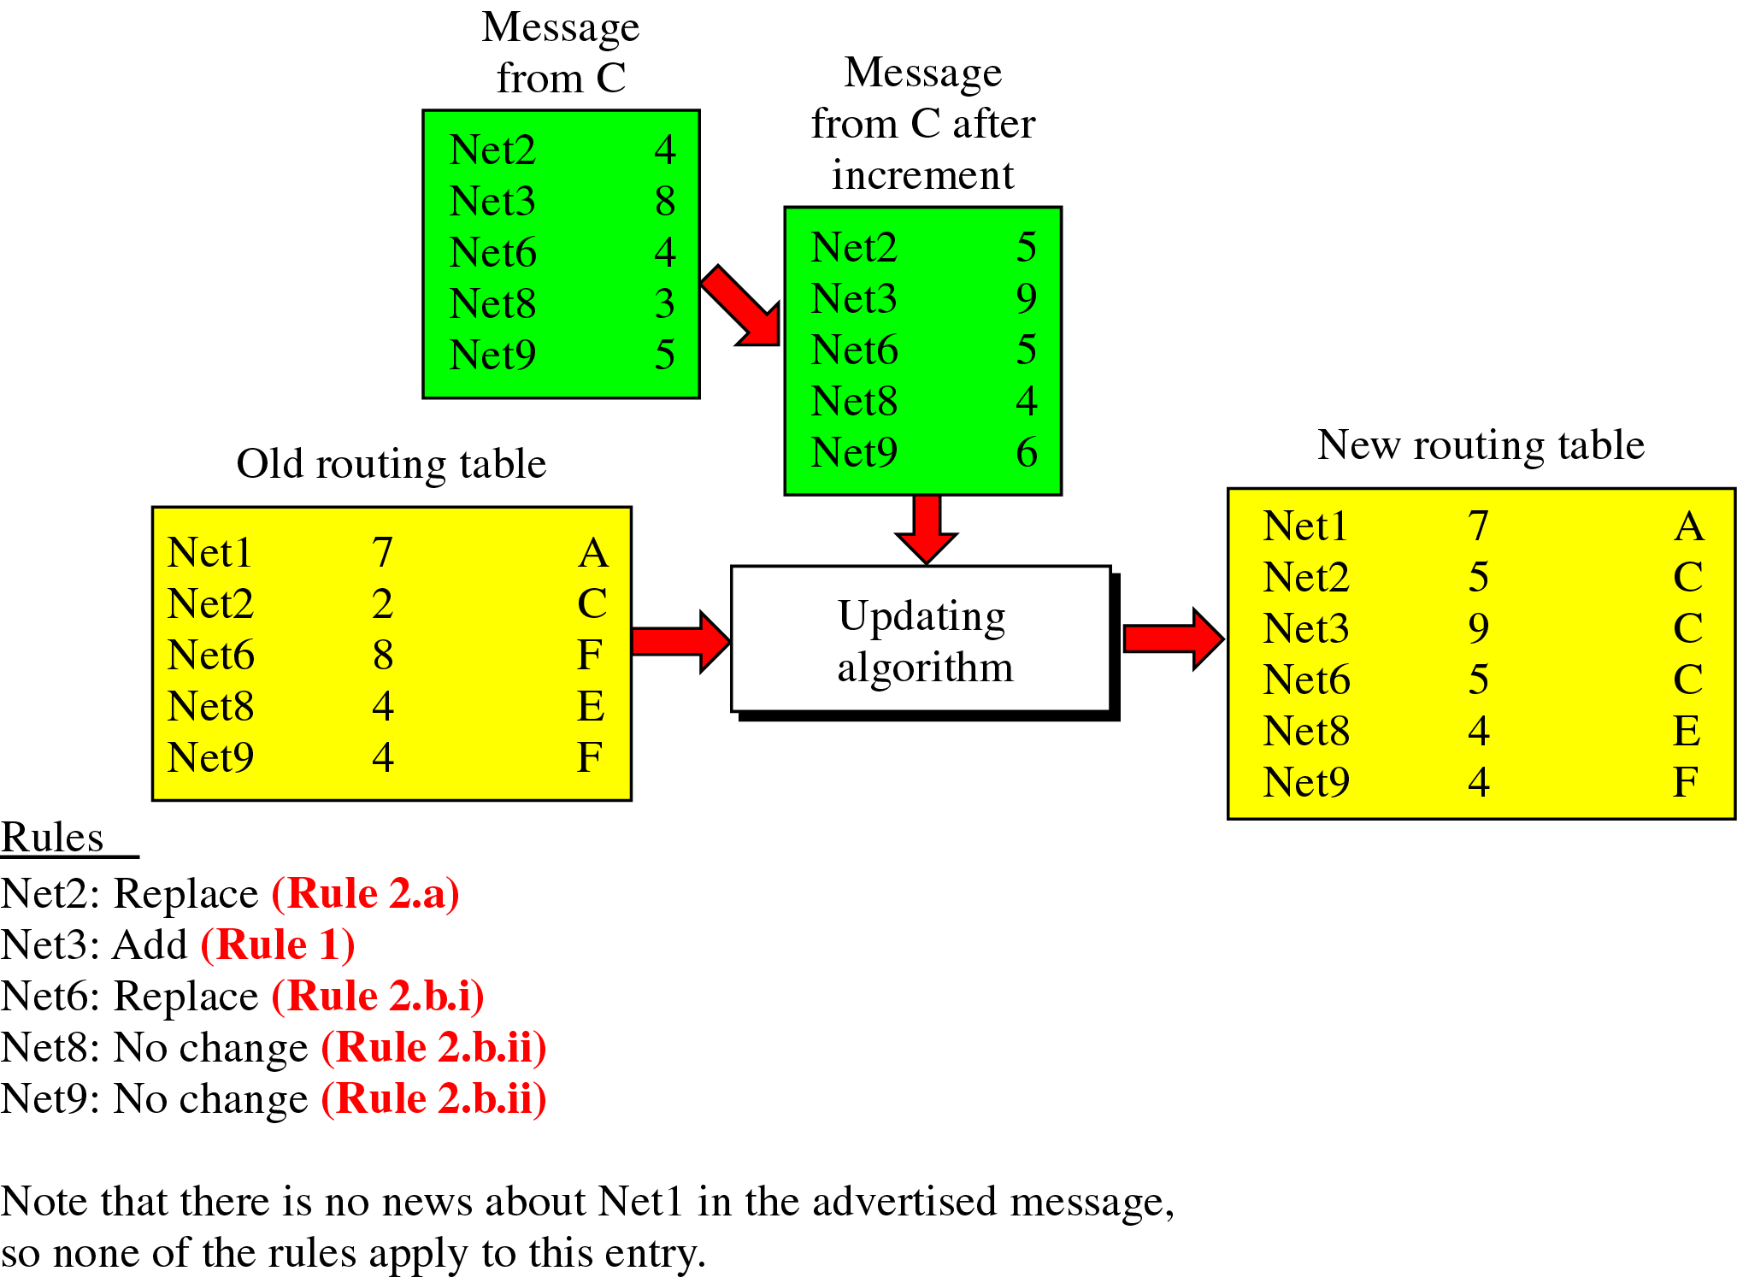
Example of updating routing table

Slide 69
Distance Vector Routing - Up gradation
The traditional updating Algorithm was found to be inefficient
Thus Distance Vector Routing later started using Bellman-Ford Algorithm for updating its routing tables
Many literatures calls DVR by names of distributed Bellman-Ford OR Ford-Fulkerson Algorithm (Bellman, 1957 and Ford and Fulkerson,1962)
Internet uses this Algorithm by name RIP (Routing Information Protocol)

Slide 70
The material in this presentation belongs to St. Francis Institute of Technology and is solely for educational purposes. Distribution and modifications of the content is prohibited.
Computer Network & Network Design
Module 3
Network Layer
Lecture 25
St. Francis Institute of Technology
Department of Information Technology
27th & 28th Feb 2025
Computer Network & Network Design
Dr. Minal Lopes

Slide 71
Link State Routing- Dynamic Routing Algorithm
Each router shares its knowledge of its neighborhood with every other router in the internetwork. It use following 3 steps:
  Knowledge about the neighborhood: instead of sending entire routing table, a router sends information about its neighborhood only
  To all routers: routers send its information to all the routers and not only neighbors. This process is called as “Flooding". Flooding means, router sends its information to all of its neighbors. Each neighbor sends the packet to all of its neighbor and so on
  Information sharing when there is a change: each router sends out information about the neighbors only when there is a change

Slide 72
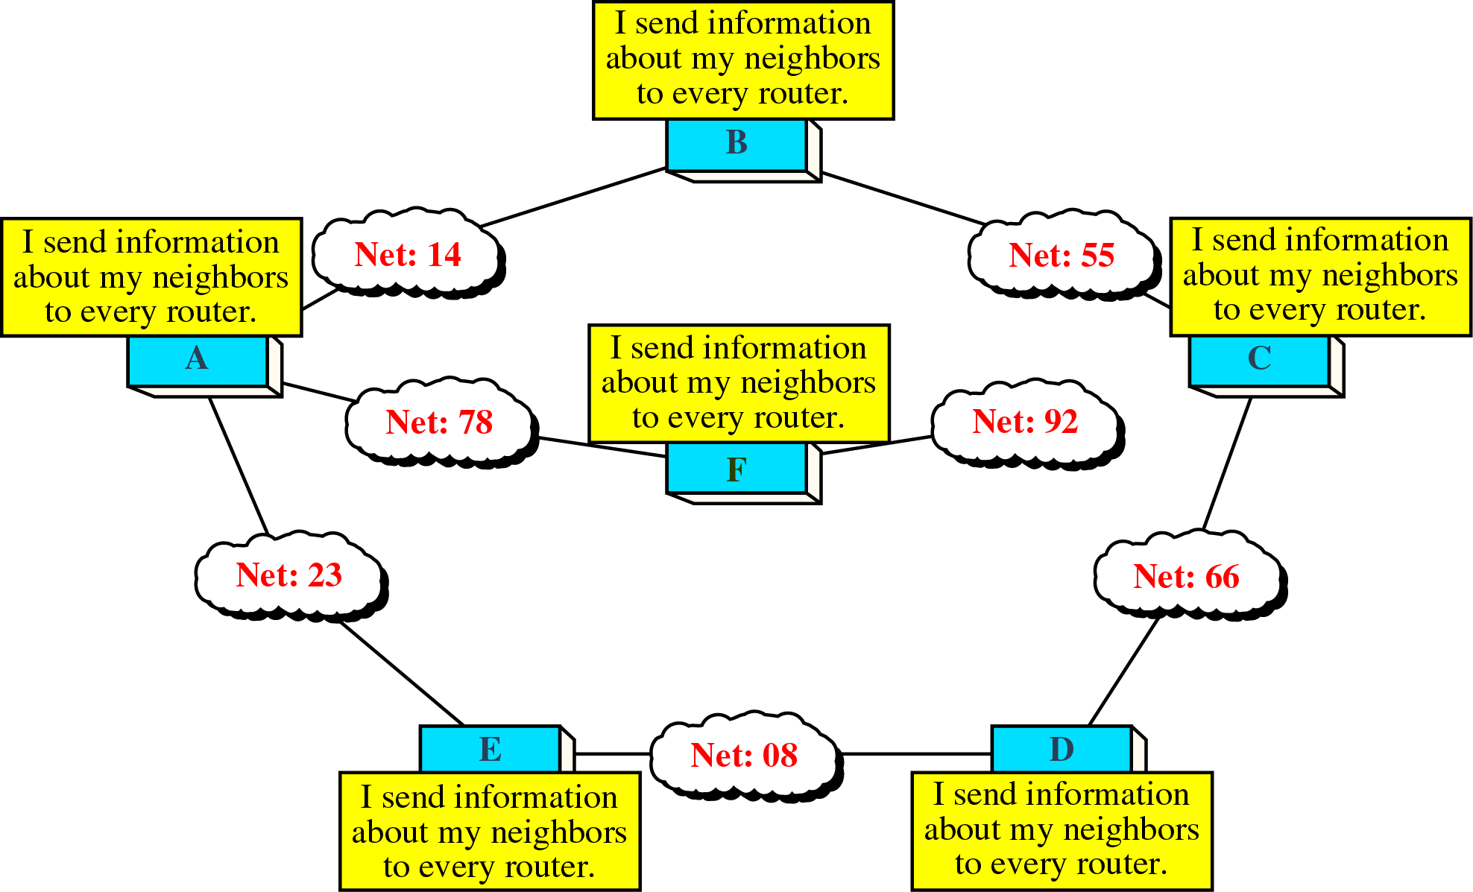
Link State Routing- Information Sharing
Each router sends its knowledge about its neighborhood to every other router in the internetwork

Slide 73
Link State Routing- Packet Cost
In link state routing, cost is weighted based on a variety of factors such as security levels, traffic or the state of the link
In determining a route, the cost of a hop is applied to each packet as it leaves a router
Two factors govern how cost is applied:
  Cost is applied only by routers
  Cost is applied as a packet leaves the router (outbound cost)

Slide 74
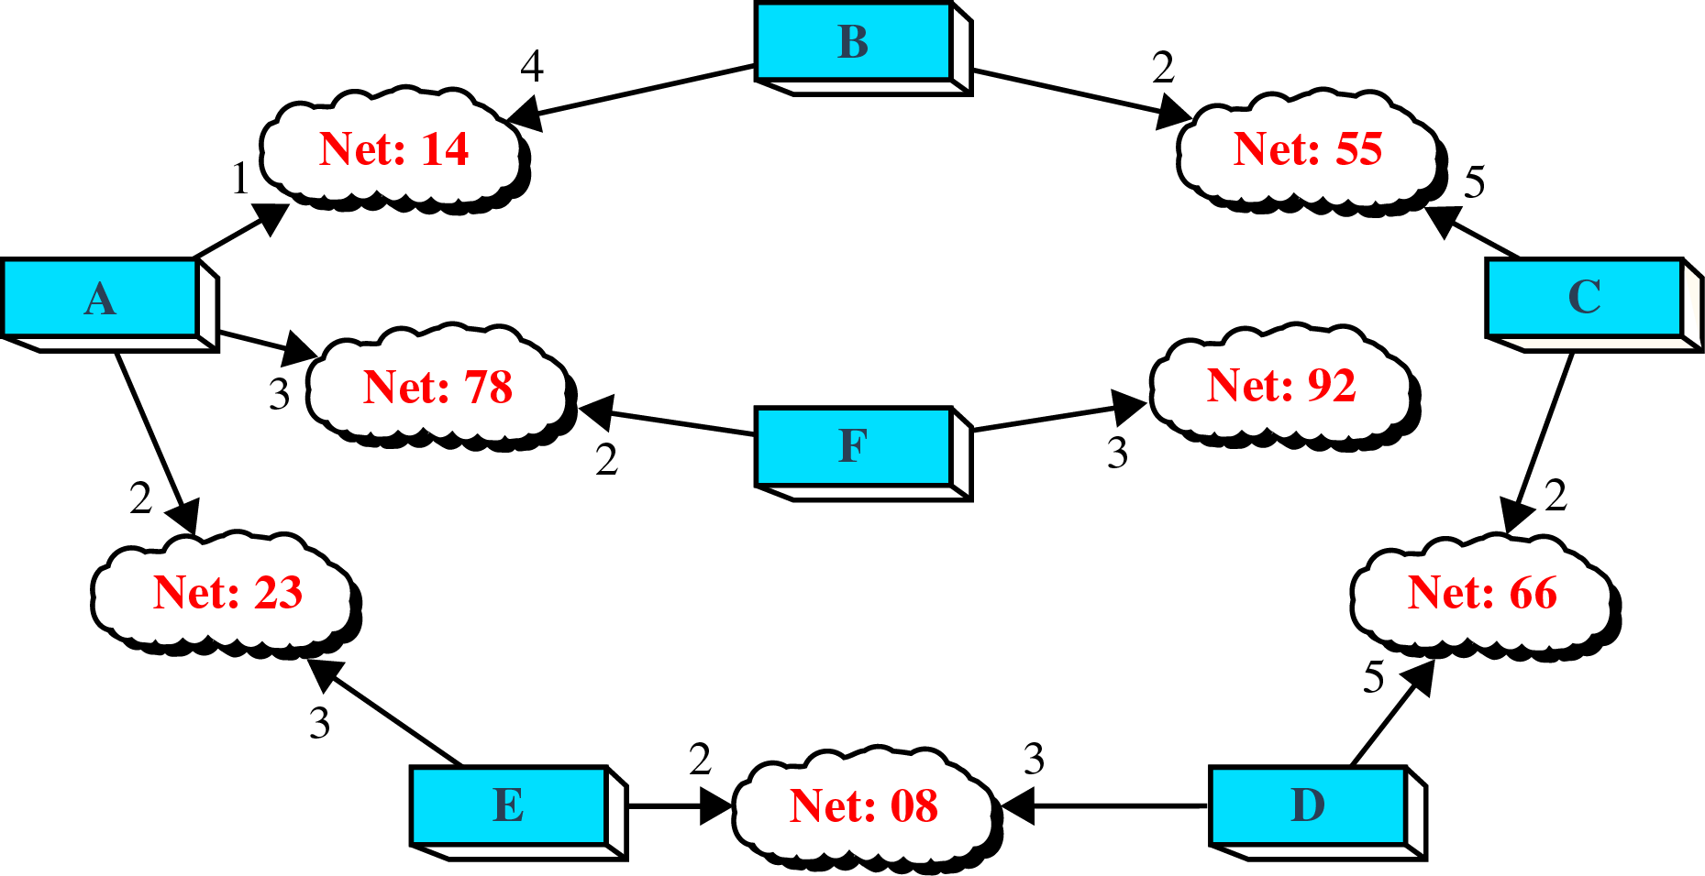
Link State Routing – applying path Cost

Slide 75
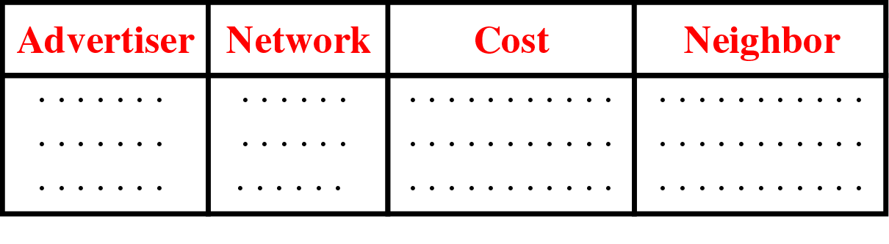
Link State Routing - Link State Packet (LSP)
When the router floods the network with information, it is said to be advertising
For advertising it uses a short packet called “Link State Packet” (LSP)
LSP has four fields: ID of advertiser, ID of destination network, the cost and the ID of neighbor router

Slide 76
Link State Routing – Greeting Packets
Initially each router sends a short greeting packet to its neighbors
If neighbor replies, it is assumed to be alive and functioning
Through this greeting packets each router find out the state of each link
Prepares an LSP based on this results and floods the network

Slide 77
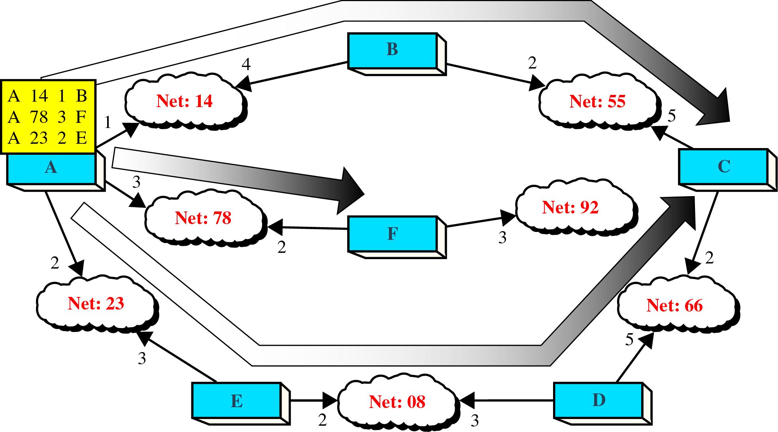
Link State Routing - Flooding of A’s LSP

Slide 78
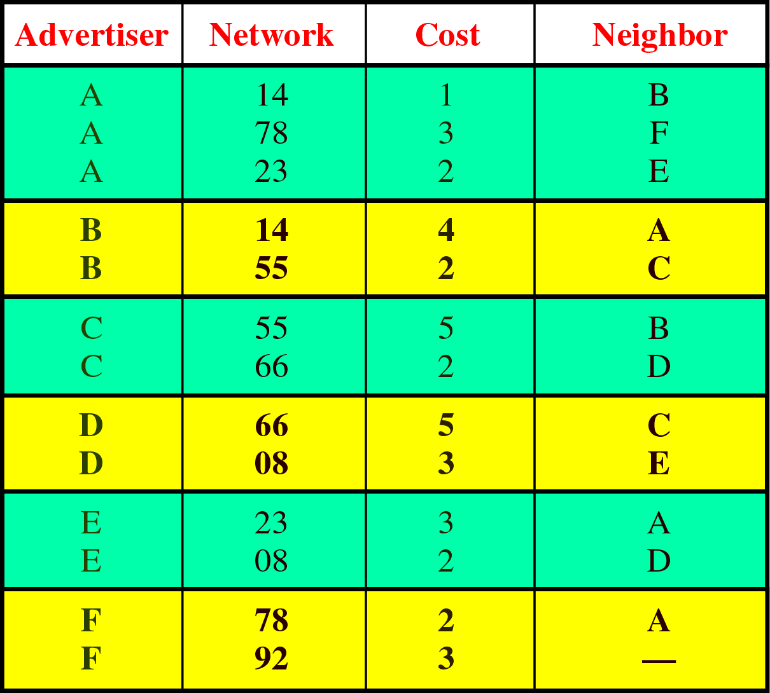
Link State Routing - Link State Database
Every router receives every LSP and puts the information into a “Link State Database”

Slide 79
Link State Routing – Updating Routing tables
This database is stored in router’s memory
Router use this database to calculate the routing table
Routers use a static algorithm called “Dijkstra’s Algorithm” for calculating the routing table
Dijkstra’s Algorithm uses a Graph made up of nodes and arcs
Rules for generating Graph:
  Nodes can be networks and routers
  Arcs are the connections between a router and the network
  Cost is applied only to the arc from router to network
  Cost of the arc from network to router is always zero

Slide 80
Revise
LSR is _____ routing protocol. (static / Dynamic)
Full form of LSR ______________.
In LSR, each router sends its routing table to the neighbors. (True /False)
In LSR, routers flood information only about their neighbors. (True /False)
In LSR, router share the information periodically. (True /False)
LSR use _______ packets to learn about link state.
LSR send ______ packets for advertising.
LSR use ________ static routing algorithm for route calculation.

Slide 81
The material in this presentation belongs to St. Francis Institute of Technology and is solely for educational purposes. Distribution and modifications of the content is prohibited.
Computer Network & Network Design
Module 3
Network Layer
Lecture 26
St. Francis Institute of Technology
Department of Information Technology
28th Feb 2025
Computer Network & Network Design
Dr. Minal Lopes

Slide 82
Routing in the Internet
Internet is made up of a large number of autonomous systems (AS)
Each AS is operated by a different organization and can use its own routing algorithm inside
E.g. internal networks of different companies
Thus we need routing at two levels, intra AS and inter AS
Standardization of the internal routing seemed to simplify inter routing to great extent
The routing algorithm within the AS is called an “Interior gateway protocol”. E.g. OSPF
An algorithm for routing between AS’s is called an “Exterior gateway protocol”. E.g. BGP
Ref Book: Computer networks- Andrew Tanenbaum, Forouzan 4th Ed – book Page 674

Slide 83
Routing in the Internet
AS 1
AS 2
Interior gateway protocol (OSPF)
Exterior gateway protocol
AS 3
AS 4
Internal router
Area

Slide 84
OSPF - Open Shortest Path First
The initial interior gateway protocol was a distance vector protocol known as Bellman-Ford algorithm
But due to its limitations, the IETF (Internet Engineering Task Force) worked on a successor, called OSPF
It became a standard in 1990, and most of the vendors now support OSPF
OSPF has some important specifications that IETF has standardized for new protocols through their long experience with the routing algorithms
Specifications:
  The protocol should be an open source. It should not be a proprietary solution owned by a company
  The protocol had to support a variety of distance metrics such as physical distance, delay, security etc

Slide 85
Routing in the Internet- OSPF
Specifications contd…..
  The algorithm should be dynamic to adapt the changes in the topology
  The routing should be based on the type of service. It should be able to give priorities and services to the specific type of traffic. (The IP protocol has a Type of service field, but no existing routing protocol including OSPF use it)
  The protocol should do load balancing, splitting the load over multiple lines. This ensures better performance
  The protocol should support hierarchical systems
  Security should be inbuilt

Slide 86
Routing in the Internet- OSPF
OSPF supports three types of connections and networks:
  Point- to- point lines between two routers
  Multi-access networks with broadcasting
  Multi-access networks without broadcasting
A multi-access network is one that can have multicasting routers on it, each of which can directly communicate with all the others
The OSPF compute the shortest path from every router to every other router
  OSPF abstracts all the networks, routers and connections into a graph
  Each arc is assigned a cost (distance, delay etc.)
  It then compute the shortest path based on the weights

Slide 87
Routing in the Internet- OSPF
WAN1
A
B
WAN 2
C
D
E
F
H
I
LAN 1
J
LAN2
G
WAN 3
W1
B
10
A
C
D
E
……………
4
0
0
0
6
3
……
2
2
L1

Slide 88
Routing in the Internet- OSPF
Some times on Internet many of the AS’s are very large and difficult to manage
OSPF allows them to be divided into numbered Areas
An Area is a network or a set of networks
An Area is a generalization of a subnet. Outside the area its topology and details are not known
Every AS has a backbone area, called Area 0
All areas are connected to the backbone by tunnels. Thus any area in the AS can be reached via a backbone
Each router that is connected to two or more areas is part of the backbone
The topology of the backbone is not visible outside the backbone

Slide 89
Routing in the Internet- OSPF
Within the area , each router has the same link state database and runs the same algorithm. Its main job is to find the shortest path from itself to every other router in the area
The router that connects two areas needs the databases for both areas and must run the algorithm for both separately
OSPF defines four classes of routers:
  Internal routers which are within one area
  Area border routers connects two or more areas
  Backbone routers are on the backbone
  AS boundary routers talk to routers in other AS’es
These router send messages to each other for updating their routing tables

Slide 90
Routing in the Internet- OSPF
Backbone router
AS 1
AS 2
AS boundary router
backbone
Exterior gateway protocol
Internal router
AS 3
AS 4
E.g. BGP protocol
Area border router
Area

Slide 91
Routing in the Internet- OSPF
Some of the message types are listed below
Message Type | Description
Hello | Used to discover who the neighbors are
Link state update | Provides the sender’s costs to its neighbors
Link state ack | Acknowledges link state updates
Database description | Announces which updates the sender has
Link state request | Requests information from the partner

Slide 92
BGP – Border Gateway Protocol (RFC: 1771-74)
It is used for routing between the autonomous systems(ASes)
The exterior gateway protocols have different issues to handle than the interior gateway protocol
The main issue to handle is politics between the corporates or countries or certain areas
E.g. A corporate AS might want the ability to send packets to any Internet site and receive packets from any Internet site
However it might be unwilling to carry transit packets originating in a foreign AS and ending in different foreign AS, even if it is on the shortest path between the two foreign ASes
Certain ASes might be willing to carry transit traffic for only those Ases that paid it for this service
BGP protocol is designed to allow many kinds of routing policies

Slide 93
Routing in the Internet- BGP
These policies are manually configured into each BGP router
From the BGP router point of view, the world consist of AS’es and the lines connecting them
BGP groups the networks in three categories:
  Stub networks: it has only one connection to the BGP router . Thus it can not be used for transit traffic
  Multi-connected networks: connected between two BGP routers. Thus can be used for transit traffic, except that they refuse
  Transit networks: the networks which are willing to handle third-party packets, possibly with some restrictions and mainly for pay

Slide 94
Routing in the Internet- BGP
Pair of BGP routers communicate with each other using TCP connections
They use distance vector router, but with certain modifications
Instead of maintaining just the cost , each BGP router keeps track of the path used
Thus each BGP router periodically share the exact path it is using instead of only cost to each possible destination

Slide 95
Routing in the Internet- BGP
B
C
D
Information that router F receives from its neighbors about D
From B: “ I use BCD”
From G: “ I use GCD”
From I: “ I use IFGCD”
From E: “ I use EFGCD”
A
G
H
F
J
E
I

Slide 96
The material in this presentation belongs to St. Francis Institute of Technology and is solely for educational purposes. Distribution and modifications of the content is prohibited.
Computer Network & Network Design
Module 3
Network Layer
Lecture 27
St. Francis Institute of Technology
Department of Information Technology
Computer Network & Network Design
Dr. Minal Lopes
xxxxxxxxxxxxxxxxxx

Slide 97
IPv6
The network layer protocol in the TCP/IP model is IPv4.
IPv4 has deficiencies, that makes it unsuitable for the fast growing Internet.
  Despite all short term solutions, such as subnetting, classless addressing and NAT, address depletion is still a long term problem.
  The Internet must accommodate real time and video transmission. This type of transmission requires minimum delay and reservation of resources. Its not supported by IPv4.
  The Internet must accommodate encryption and authentication of data for some applications. IPv4 do not provide any of this.
Ref Book: Forouzan 4th Ed – book Page 628

Slide 98
IPv6
IPv6 was extensively modified to support growth of Internet.
Length & packet format is changed.
Related protocols such as ARP, RARP and IGMP are merged with ICMPv6
Routing protocols are also changed to support IPv6.
Adoption of IPv6 is slow, as it needs infrastructural, device and protocol changes in networks.
However services like mobile IP, IP telephony, IoT, will require total replacement on IPv4 with IPv6.
Ref Book: Forouzan 4th Ed – book Page 628

Slide 99
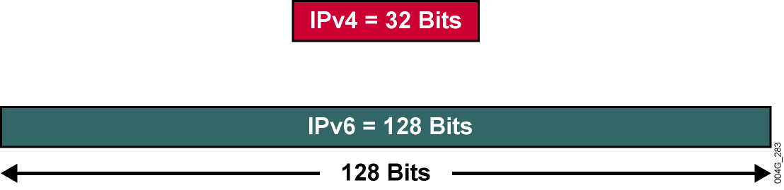
IPv6 Address Structure
x:x:x:x:x:x:x:x, where x is 16 bits, represented by a hexadecimal number:
  E.g. - 2031:0000:130F:0000:0000:09C0:876A:130B
  Can be also written as 2031:0:130F::9C0:876A:130B
  A pair of colons (::) can be used only once within an IPv6 address.
  Note - An all-0s address can be written as ::
Notes:
Fortunately, you can shorten the written form of IPv6 addresses.
Leading 0s within each set of four hexadecimal digits can be omitted, and a pair of colons (::) can be used,
Once within an address,
to represent any number of successive 0s.

Slide 100
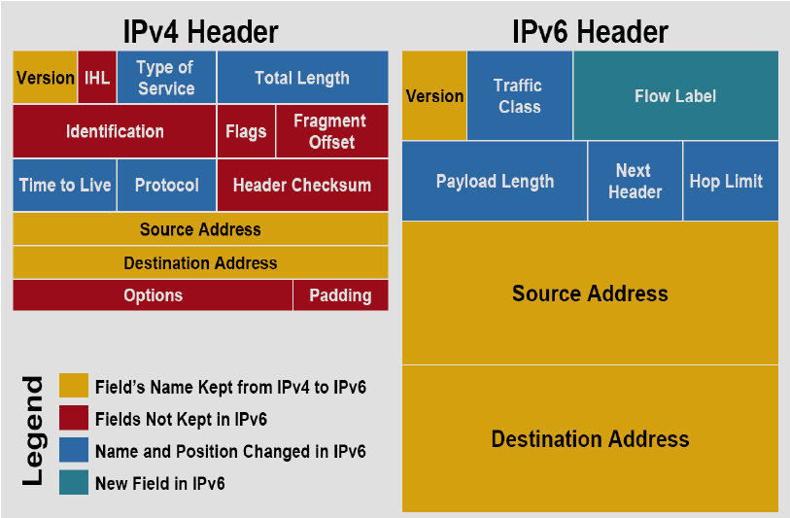
IPv6 Packet Header

Slide 101
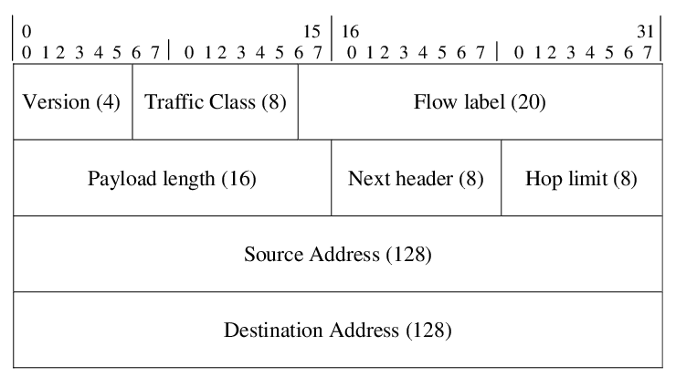
IPv6 Packet Header
The IPv6 header has 40 octets, in contrast to the 20 octets in the IPv4 header.
IPv6 has fewer fields, and the header is 64-bit - aligned to enable fast, efficient, hardware-based processing.
The IPv6 address fields are four times larger than in IPv4.
4 octets
4 octets
16 octets
16 octets

Slide 102
IPv6 Packet Header
Version: A 4-bit field. For IPv6, this field contains the number 6.
Traffic class: An 8-bit field similar to the type of service (ToS) field in IPv4. This field tags the packet with a traffic class that it uses in differentiated services (DiffServ) QoS. These functions are the same for IPv6 and IPv4.
Flow label: This 20-bit field is new in IPv6. It can be used by the source of the packet to tag the packet as being part of a specific flow, allowing multilayer switches and routers to handle traffic on a per-flow basis rather than per-packet, for faster packet-switching performance. This field can also be used to provide QoS.

Slide 103
IPv6 Packet Header
Payload length: This 16-bit field is similar to the IPv4 total length field.
Next header: The value of this 8-bit field determines the type of information that follows the basic IPv6 header. It can be transport-layer information, such as TCP or UDP, or it can be an extension header. The next header field is similar to the protocol field of IPv4.
Hop limit: This 8-bit field specifies the maximum number of hops that an IPv6 packet can traverse. Similar to the time to live (TTL) field in IPv4, each router decreases this field by 1. Because there is no checksum in the IPv6 header, an IPv6 router can decrease the field without recomputing the checksum; in IPv4 routers, the recomputation costs processing time. If this field ever reaches 0, a message is sent back to the source of the packet, and the packet is discarded.

Slide 104
IPv6 Packet Header
Source address: This field has 16 octets (128 bits). It identifies the source of the packet.
Destination address: This field has 16 octets (128 bits). It identifies the destination of the packet.
Extension headers: The extension headers, if any, and the data portion of the packet follow the other eight fields. The number of extension headers is not fixed, so the total length of the extension header chain is variable.

Slide 105
The material in this presentation belongs to St. Francis Institute of Technology and is solely for educational purposes. Distribution and modifications of the content is prohibited.
Computer Network & Network Design
Module 3
Network Layer
Lecture 28
St. Francis Institute of Technology
Department of Information Technology
xxxxxxxxxxxxxxxxx
Computer Network & Network Design
Dr. Minal Lopes

Slide 106
IPv4-to-IPv6 Transition
Following are three primary mechanisms for the transition from IPv4 to IPv6:
  Dual-stack: Both the IPv4 and the IPv6 stacks run on a system that can communicate with both IPv6 and IPv4 devices.
  Tunneling: Uses encapsulation of IPv6 packets to traverse IPv4 networks and vice versa.
  Header Translation: A mechanism that translates one protocol to the other to facilitate communication between the two networks.

Slide 107

Three transition strategies

Slide 108
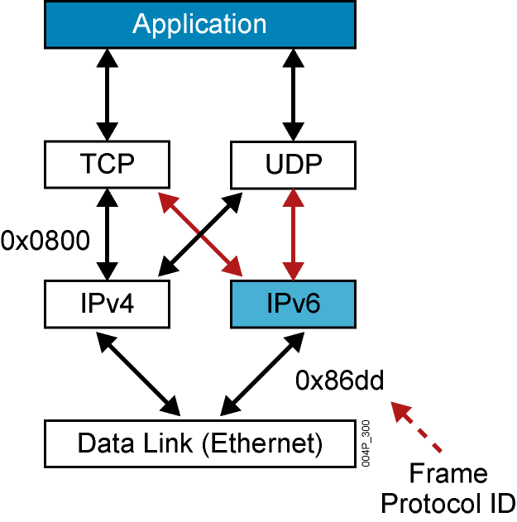

IPv4-to-IPv6 Transition- Dual-Stack Transition Mechanism
0x0800
Notes:
A dual-stack node enables both IPv4 and IPv6 stacks.
Applications communicate with both IPv4 and IPv6 stacks;
The IP version choice is based on name lookup and application preference.
This is the most appropriate method for campus and access networks during the transition period,
and it is the preferred technique for transitioning to IPv6.
A dual-stack approach supports the maximum number of applications.
Operating systems that support the IPv6 stack include FreeBSD, Linux, Sun Solaris, and Windows.

Slide 109
Dual-Stack Transition Mechanism
A dual-stack node enables both IPv4 and IPv6 stacks.
Applications communicate with both IPv4 and IPv6 stacks;
To determine which version to use when sending a packet to a destination, the source host queries DNS (domain name server). If DNS returns an IPv4 address, the source host sends IPv4 packet. If DNS returns IPv6 address, source sends IPv6 packet.
This is the most preferred technique for transitioning to IPv6.
A dual-stack approach supports the maximum number of applications.
Operating systems that support the IPv6 stack include FreeBSD, Linux, Sun Solaris, and Windows.

Slide 110
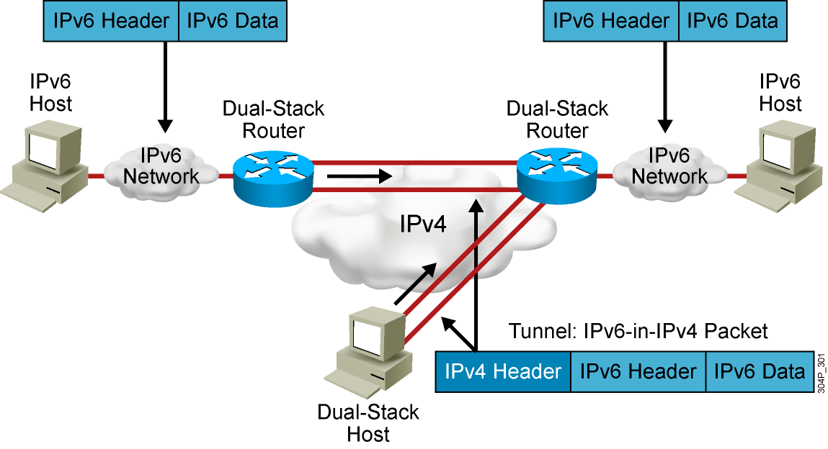
Tunneling Transition Mechanism
Notes:
The purpose of tunneling is to encapsulate packets of one type in packets of another type.
When transitioning to IPv6, tunneling encapsulates IPv6 packets in IPv4 packets.
By using overlay tunnels, isolated IPv6 networks can communicate without having to upgrade the IPv4 infrastructure between them.
Both routers and hosts can use tunneling.

Slide 111

Tunneling strategy

Slide 112
Tunneling Transition Mechanism
Tunneling is used when two computers using IPv6 want to communicate with each other and the packet must pass through a region that use IPv4.
To pass through this region, the packet must have an IPv4 address. So the IPv6 packet is encapsulated in an IPv4 packet when it enters the region and it leaves its capsule when it exits the region.
It seems as if the IPv6 packet goes through a tunnel at one end and emerges at the other end.
To make it clear that the IPv4 packet is carrying an IPv6 packet as data, the protocol value in packet header is set to 41.

Slide 113
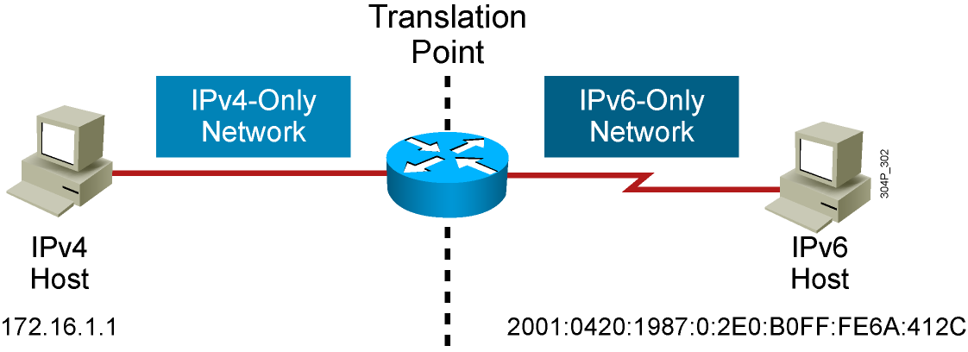
Header Translation Mechanism
Notes:
Translation Transition Mechanism is used for legacy equipments that will not be upgraded to IPv6
and for some deployment scenarios where connecting IPv4-only nodes to IPv6-only nodes is required.
Translation is an extension of NAT techniques.
As can be seen in figure, An IPv6 node behind a translation device has full connectivity to other IPv6 nodes and uses NAT functionality to communicate with IPv4 devices.

Slide 114

Header translation strategy

Slide 115
Header Translation Rules

Slide 116
The material in this presentation belongs to St. Francis Institute of Technology and is solely for educational purposes. Distribution and modifications of the content is prohibited.
Computer Network & Network Design
Module 3
Network Layer
Lecture 29
St. Francis Institute of Technology
Department of Information Technology
14th & 15th March 2023
Computer Network & Network Design
Dr. Minal Lopes

Slide 117
Assigning IP Addresses
Static IP Assignment
  An IP address is statically assigned to a system.
  The network administrator configures the IP address, default gateway, and name servers manually by entering them into a special file or files on the end system with either a graphical or text interface.
  Static address assignment is an extra burden for the administrator—especially on large-scale networks— who must configure the address on every end system in the network.
Ref Book: Forouzan 4th Ed –Topic: DHCP, book Page 620

Slide 118
Assigning IP Addresses
Dynamic IP Assignment
  IP addresses are dynamically assigned to the end systems.
  Dynamic address assignment relieves the administrator of manually assigning an address to every network device.
  Instead, the administrator must set up a server to assign the addresses.
  On that server, the administrator defines the address pools and additional parameters that should be sent to the host (default gateway, name servers, time servers, and so forth).
  On the host, the administrator enables the host to acquire the address dynamically; this is often the default.
  When IP address reconfiguration is needed, the administrator reconfigures the server, which then performs the host-renumbering task.
Examples of available address assignment protocols include Reverse Address Resolution Protocol, Boot Protocol, and DHCP.
DHCP is the newest and provides the most features.

Slide 119
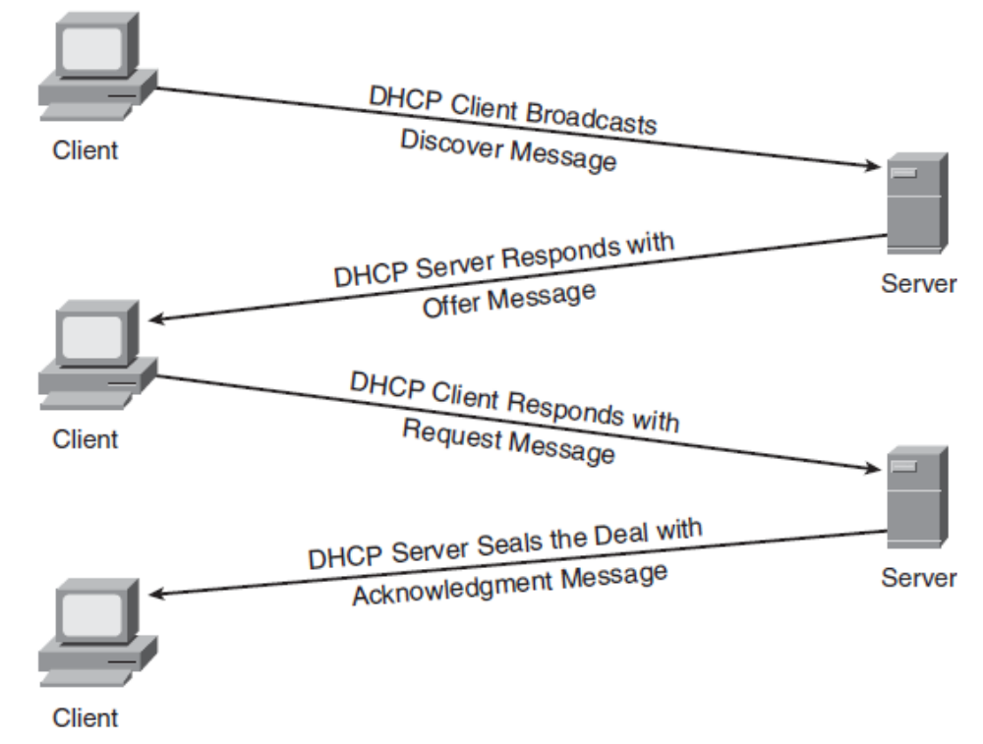
Dynamic Host Configuration Protocol (DHCP) Operation

Slide 120
DHCP Operation - steps
Step 1 The host sends a DHCPDISCOVER broadcast message to locate a DHCP server.
Step 2 A DHCP server offers configuration parameters such as an IP address, a MAC address, a domain name, a default gateway, and a lease for the IP address to the client in a DHCPOFFER unicast message.
Step 3 The client returns a formal request for the offered IP address to the DHCP server in a DHCPREQUEST broadcast message.
Step 4 The DHCP server confirms that the IP address has been allocated to the client by returning a DHCPACK unicast message to the client.

Slide 121
The material in this presentation belongs to St. Francis Institute of Technology and is solely for educational purposes. Distribution and modifications of the content is prohibited.
Computer Network & Network Design
Module 3
Network Layer
Lecture 30
St. Francis Institute of Technology
Department of Information Technology
15th & 17th March 2023
Computer Network & Network Design
Dr. Minal Lopes

